Slide 1


Slide 2
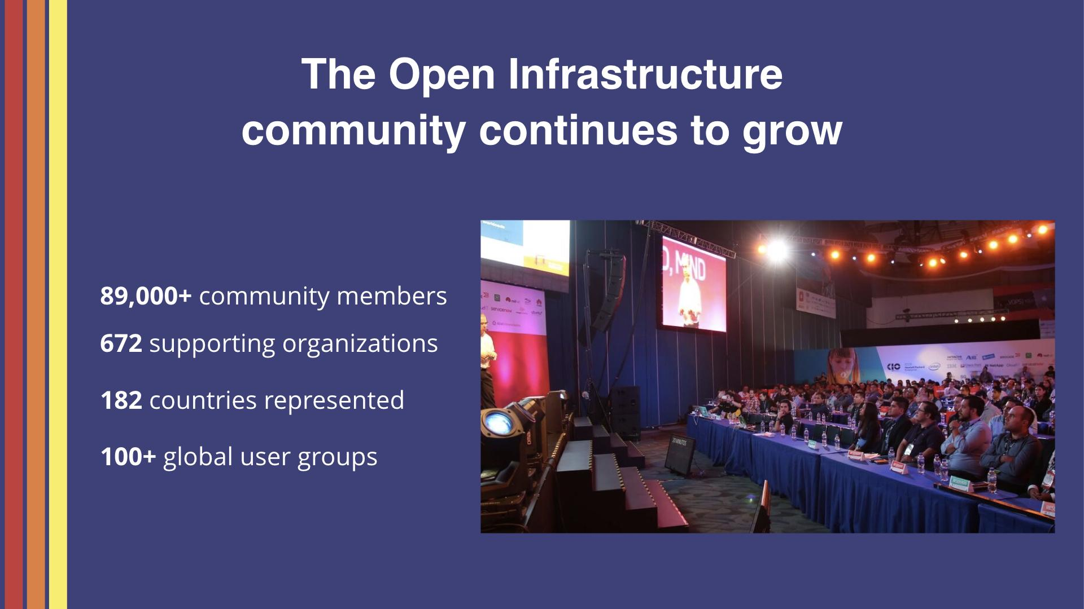

Slide 3
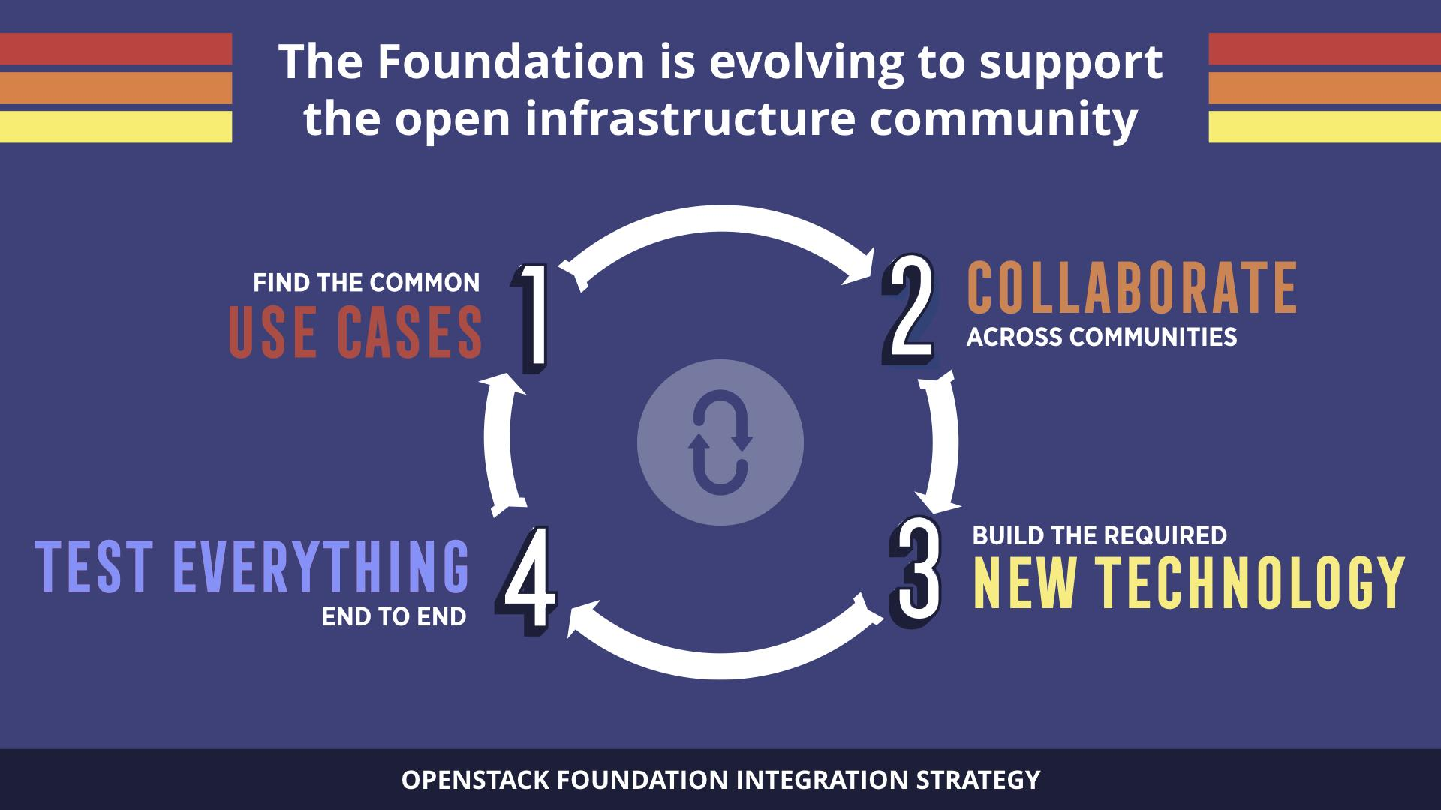

Slide 4
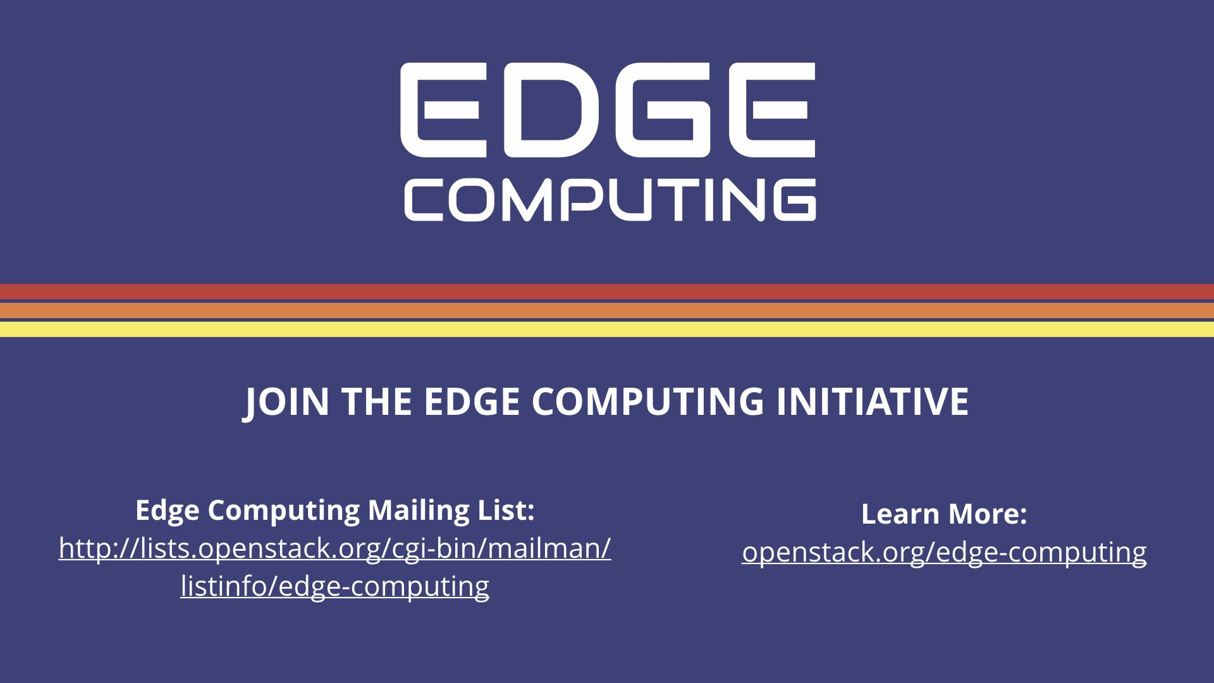

Slide 5
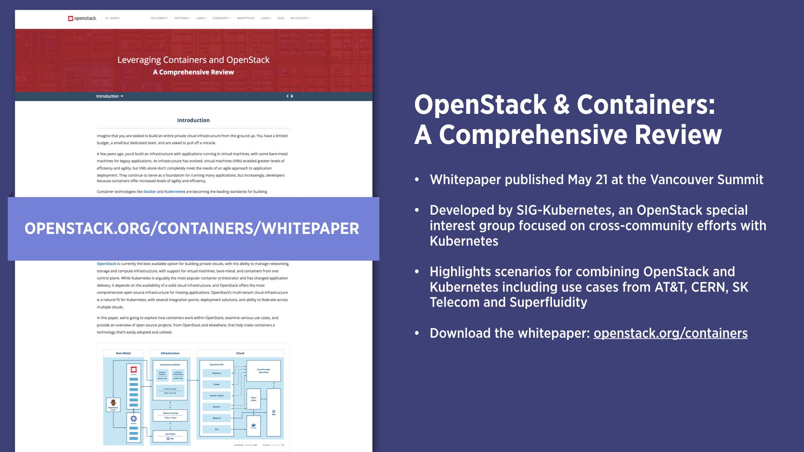

Slide 6
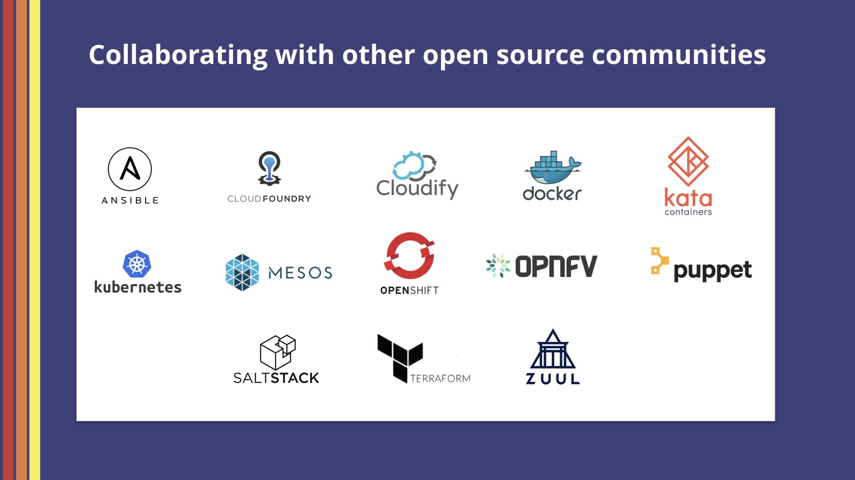

Slide 7
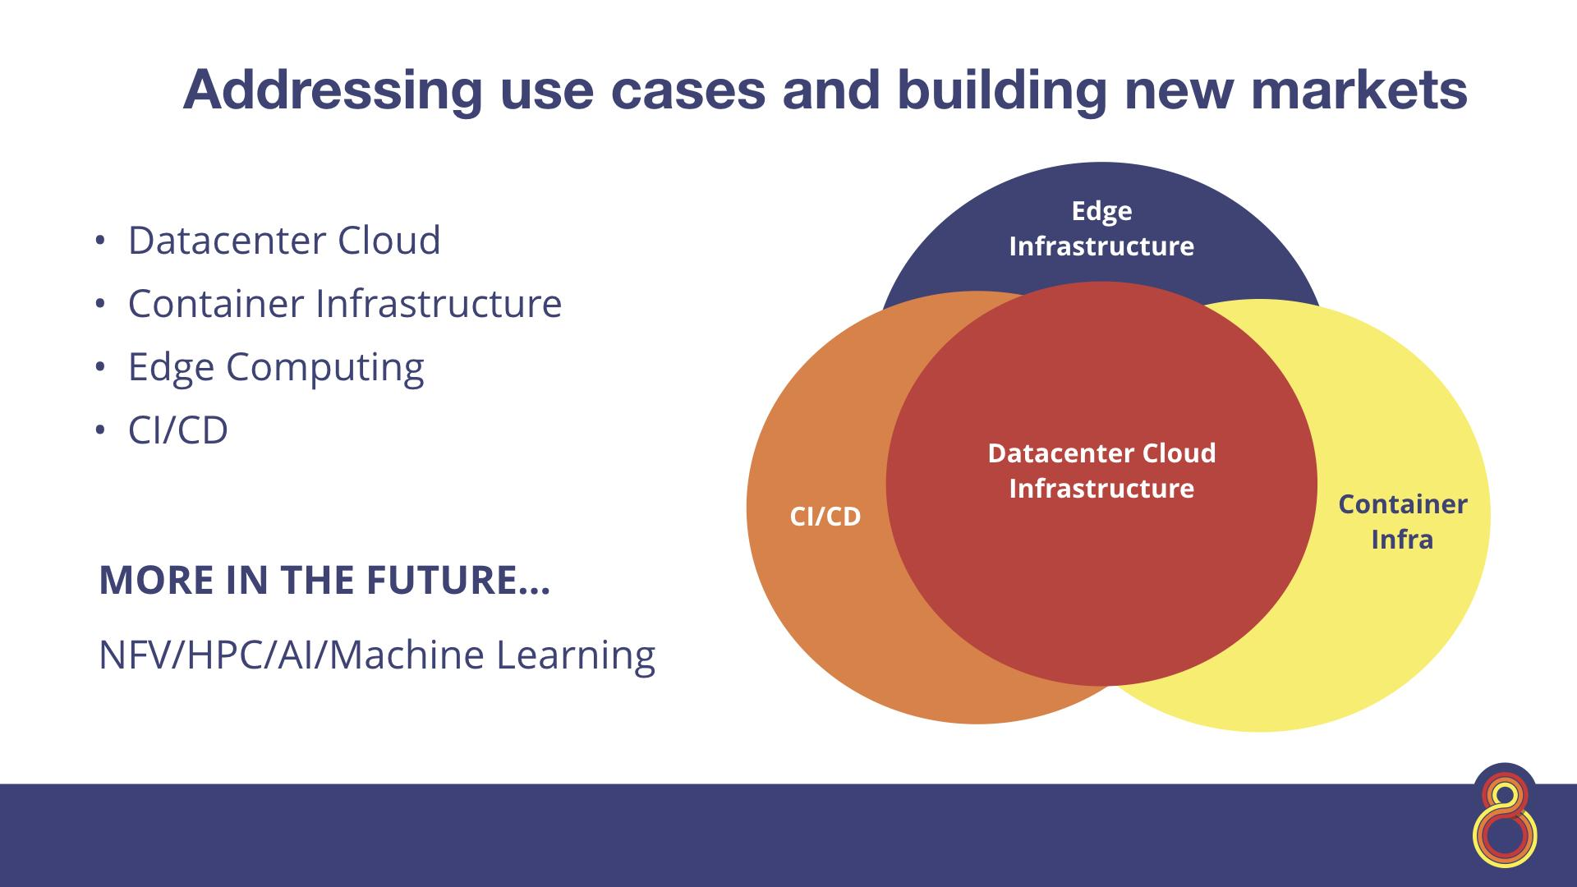

Slide 8
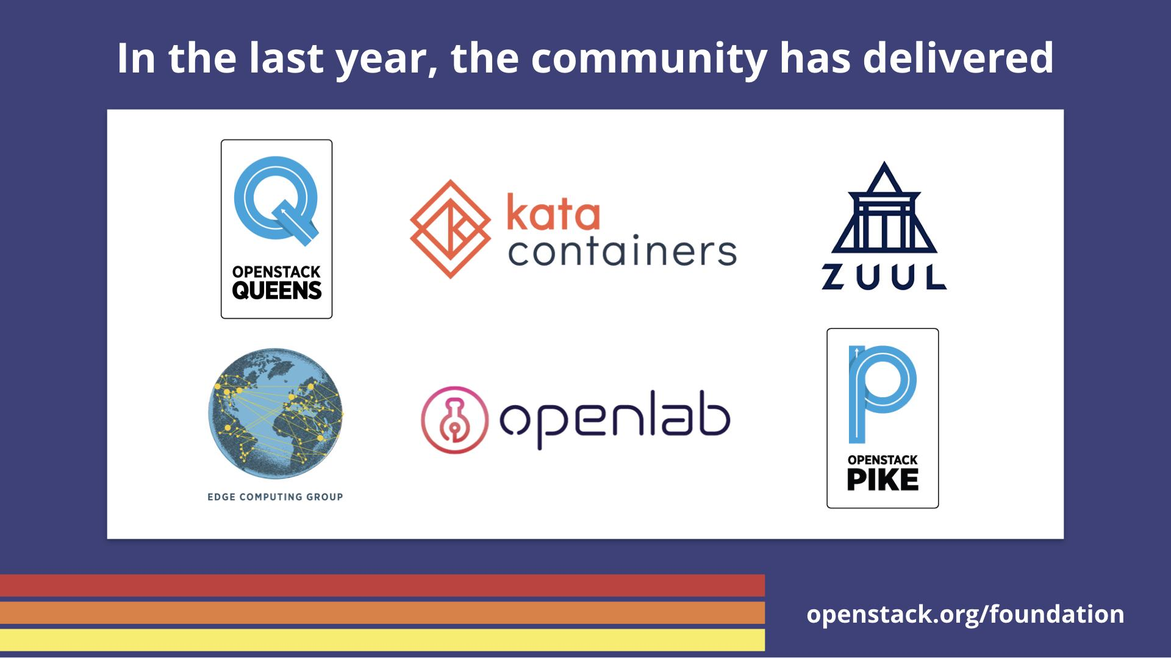

Slide 9
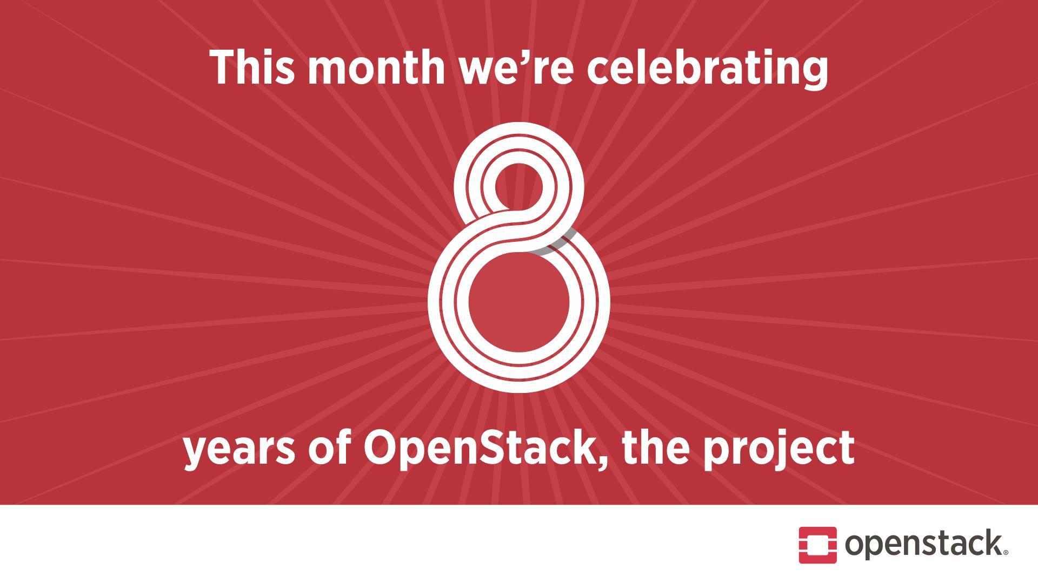

Slide 10
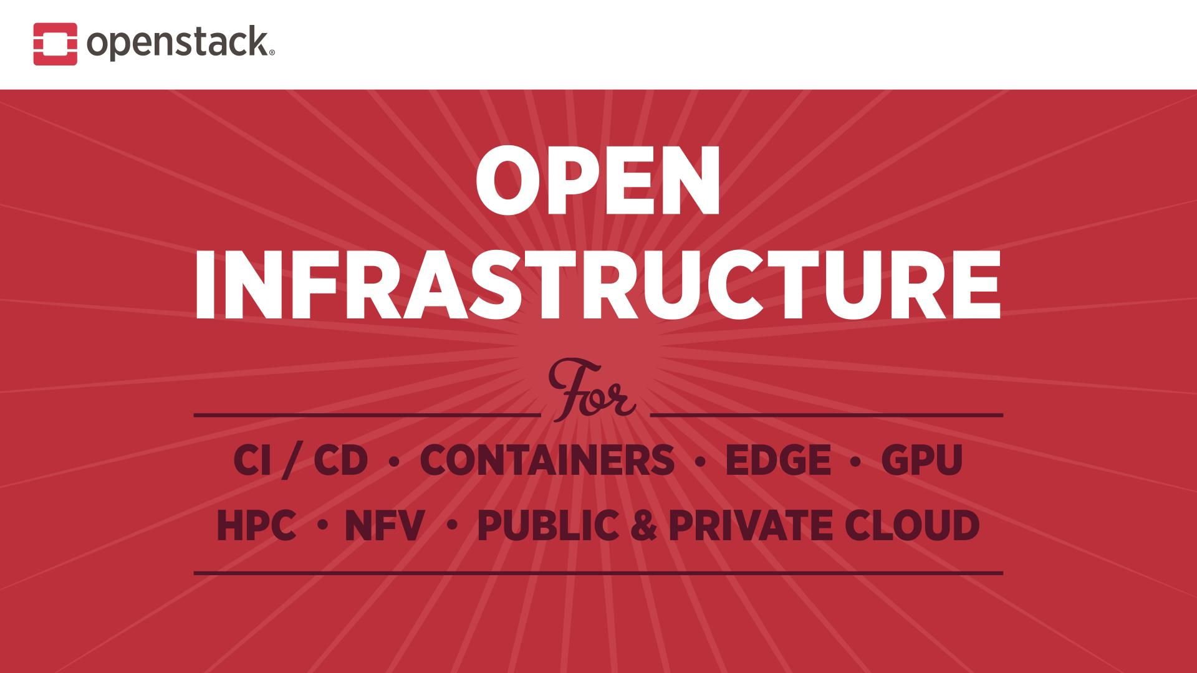

Slide 11
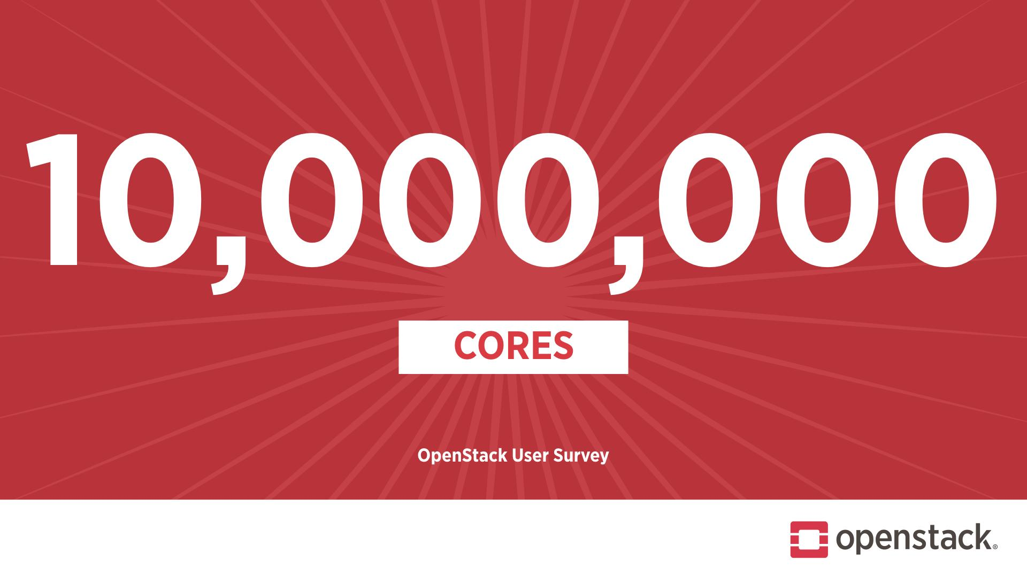

Slide 12
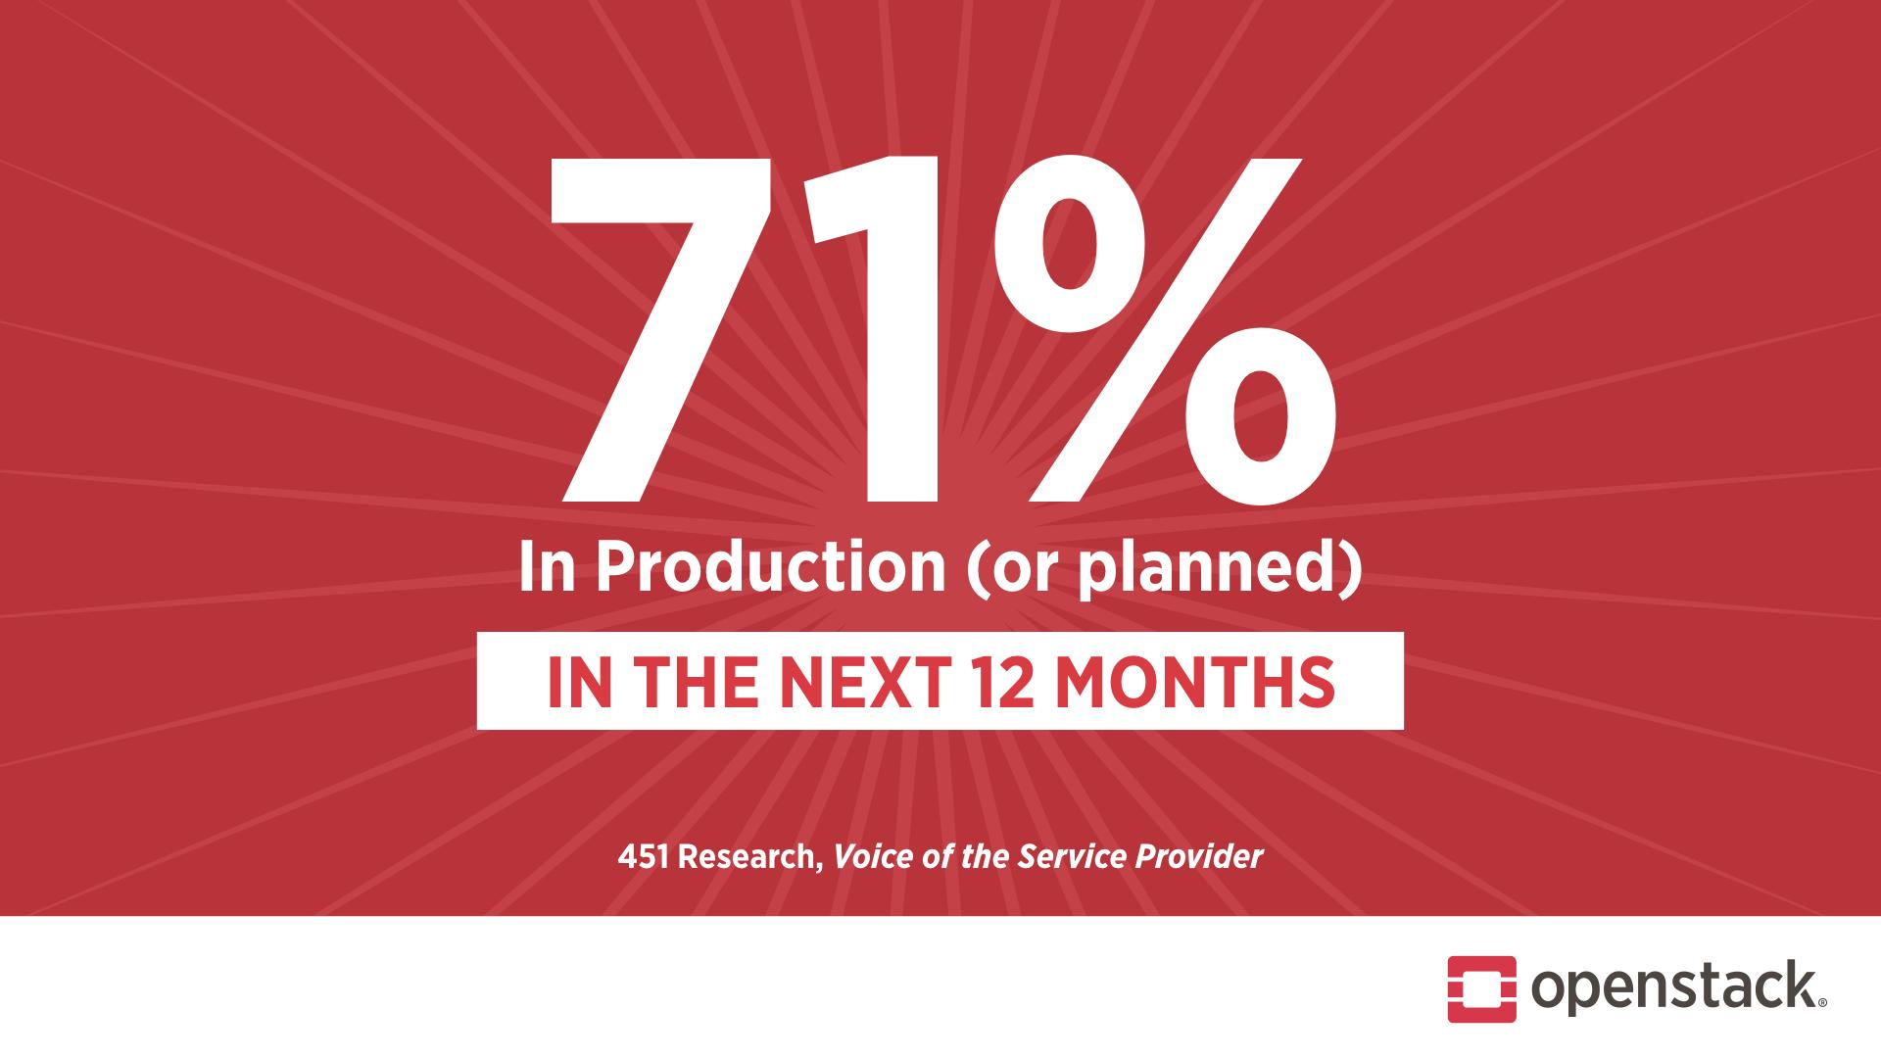

Slide 13
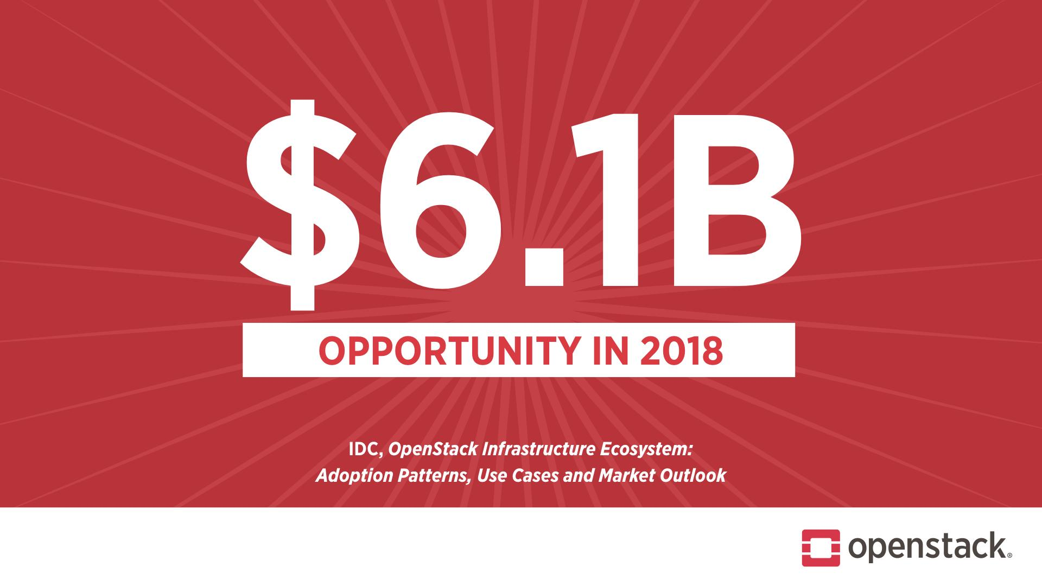

Slide 14
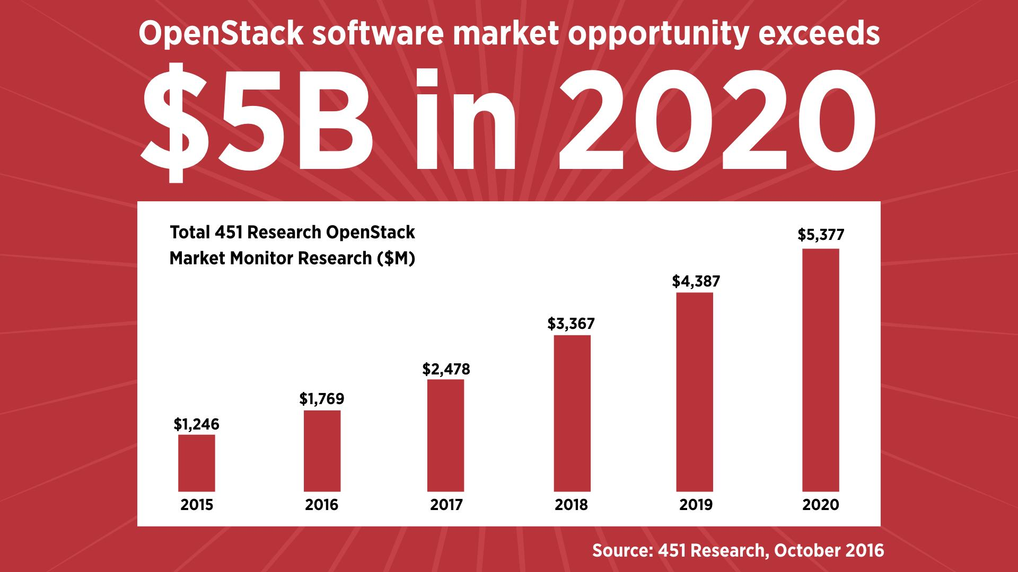

Slide 15
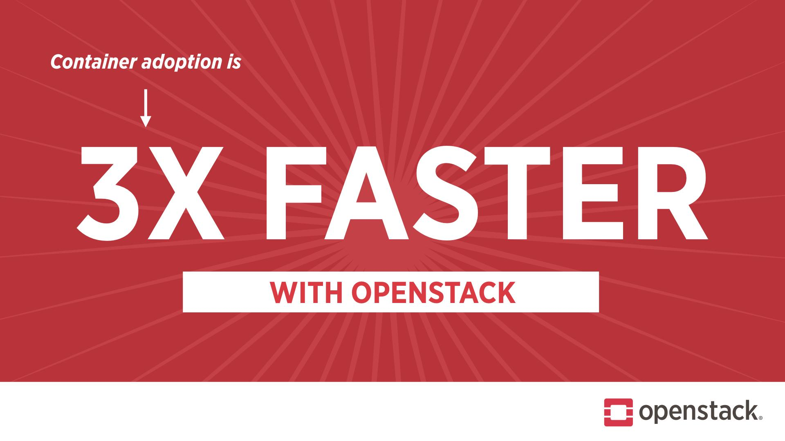

Slide 16
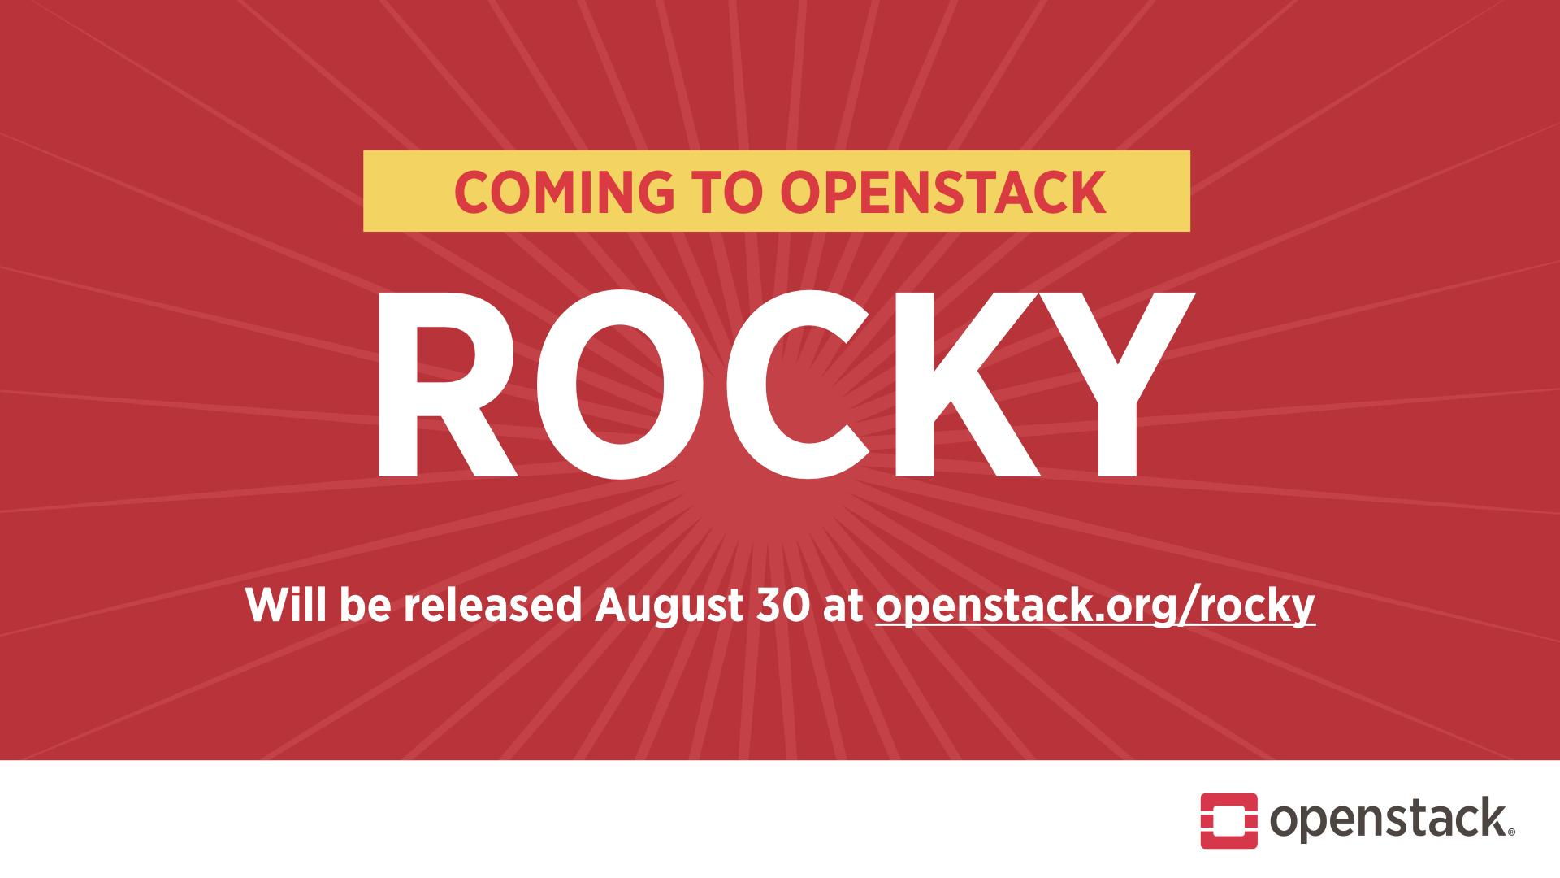

Slide 17
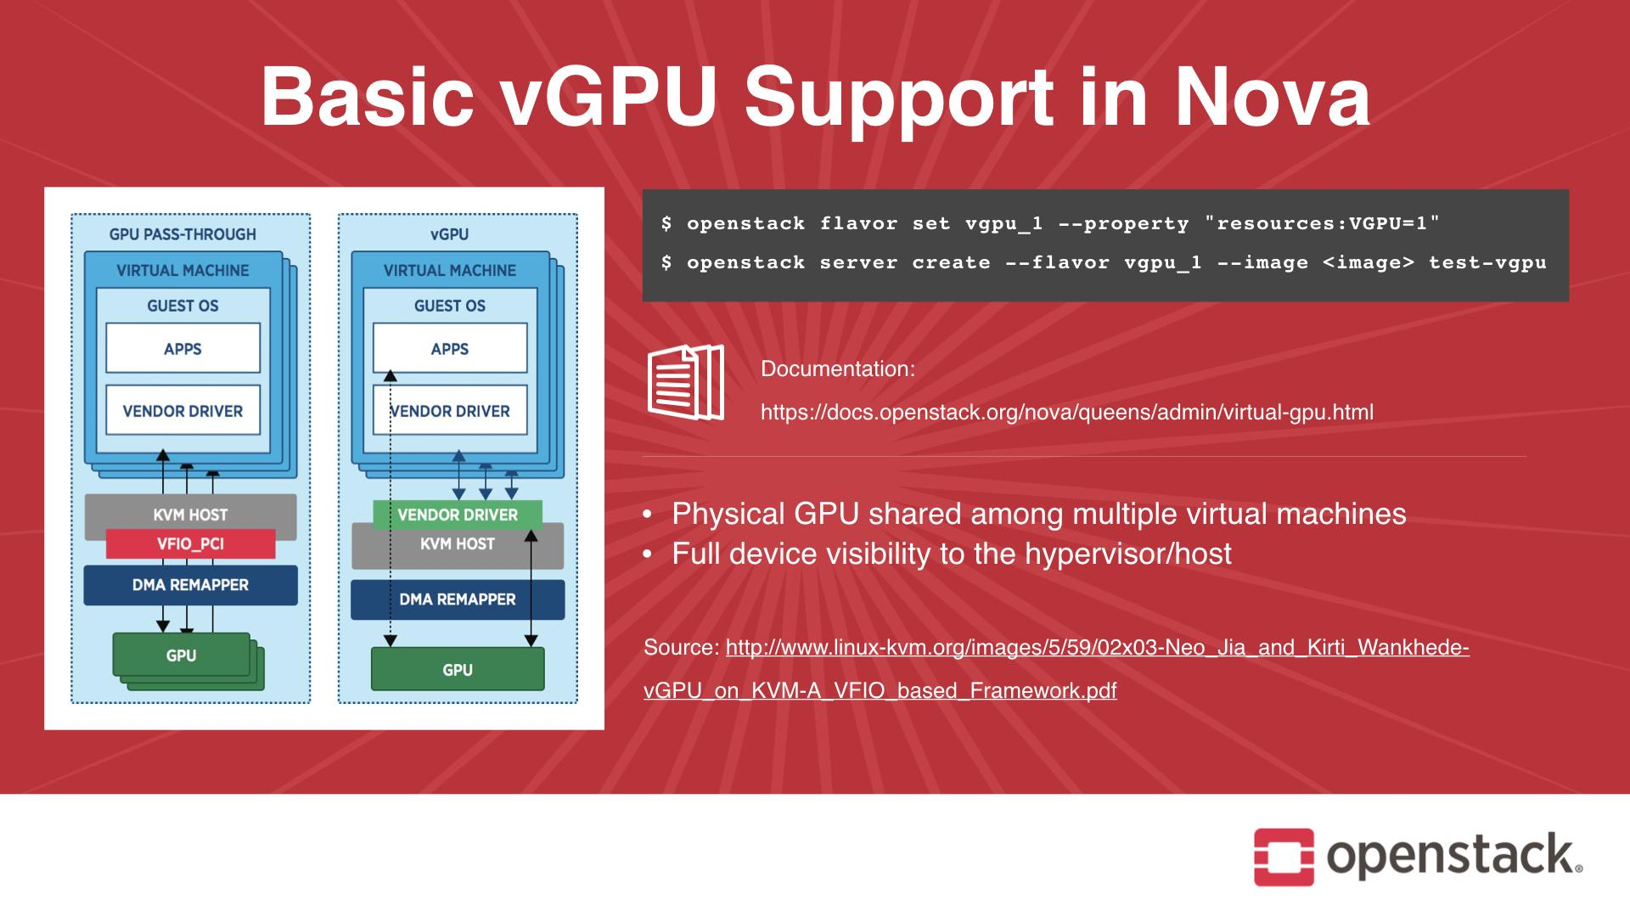

Slide 18
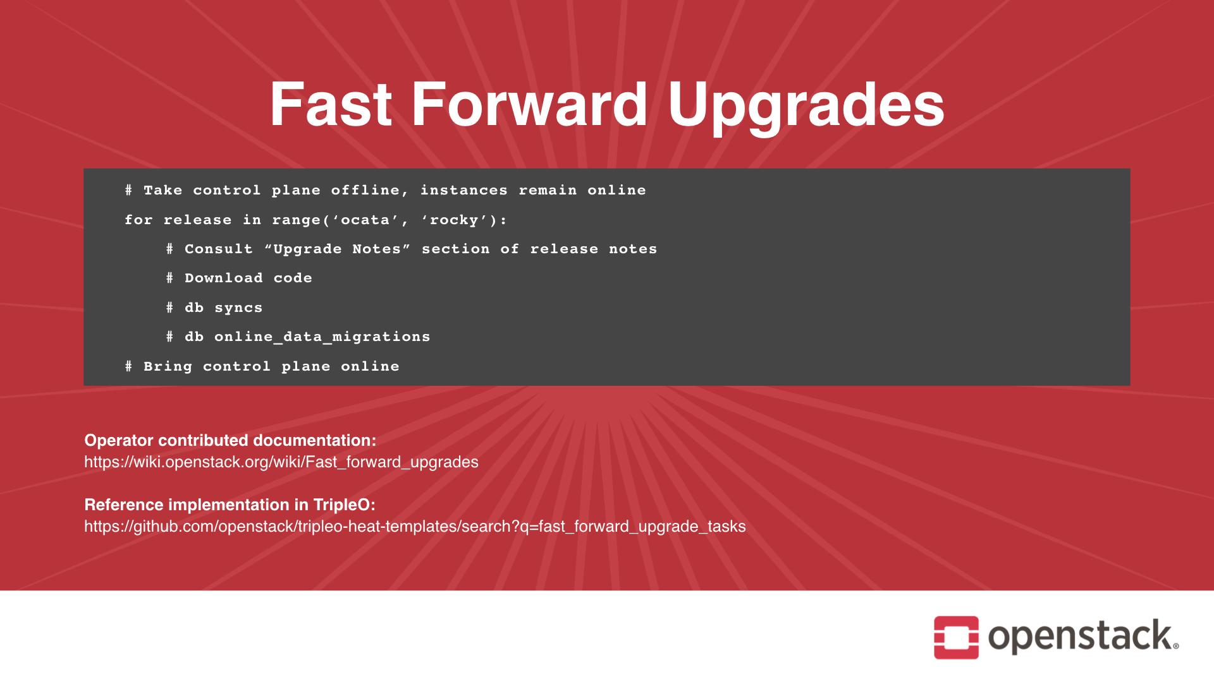

Slide 19
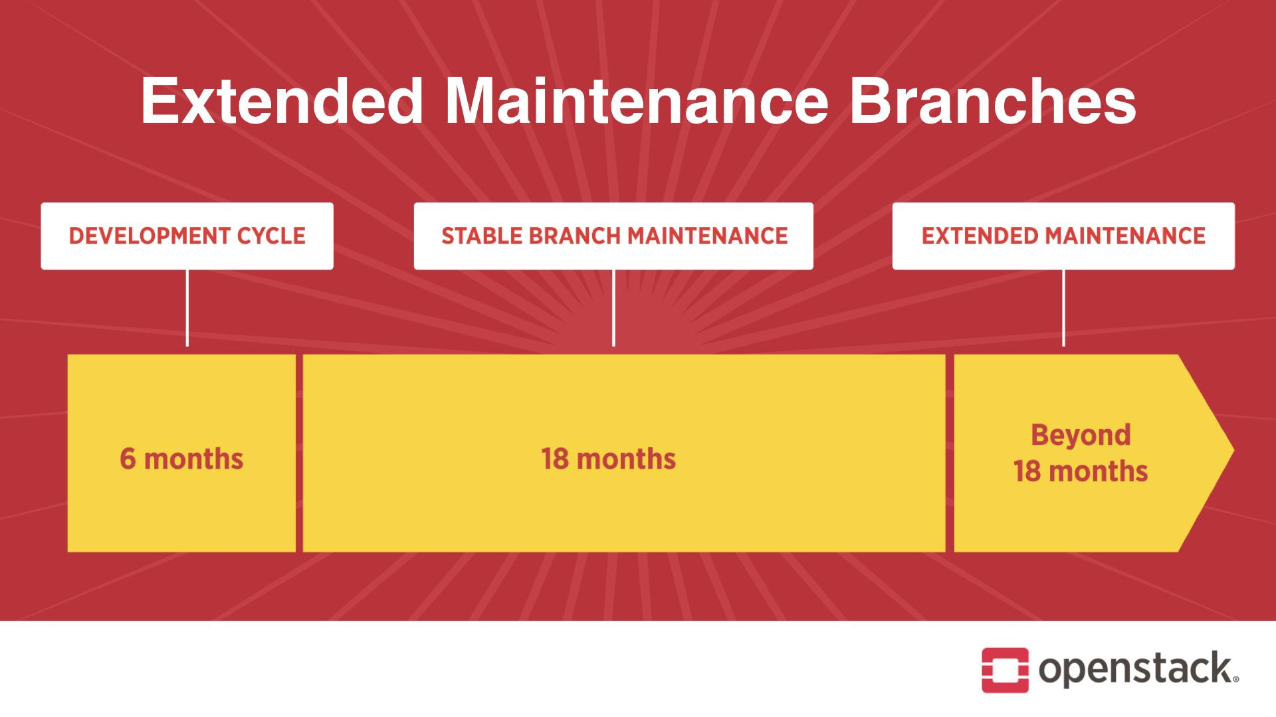
Notes:
* Extending the basic stable policy to 18 months
* Dropping phases and simplifying rules about backports
* All bug fixes, no features
* Tagged releases
* After 18 months
* Maintenance depends on community members joining the stable team
* Same bug fix, no feature, policy
* No tagged releases
* 2 forum sessions on Thursday morning starting at 9:00

Slide 20
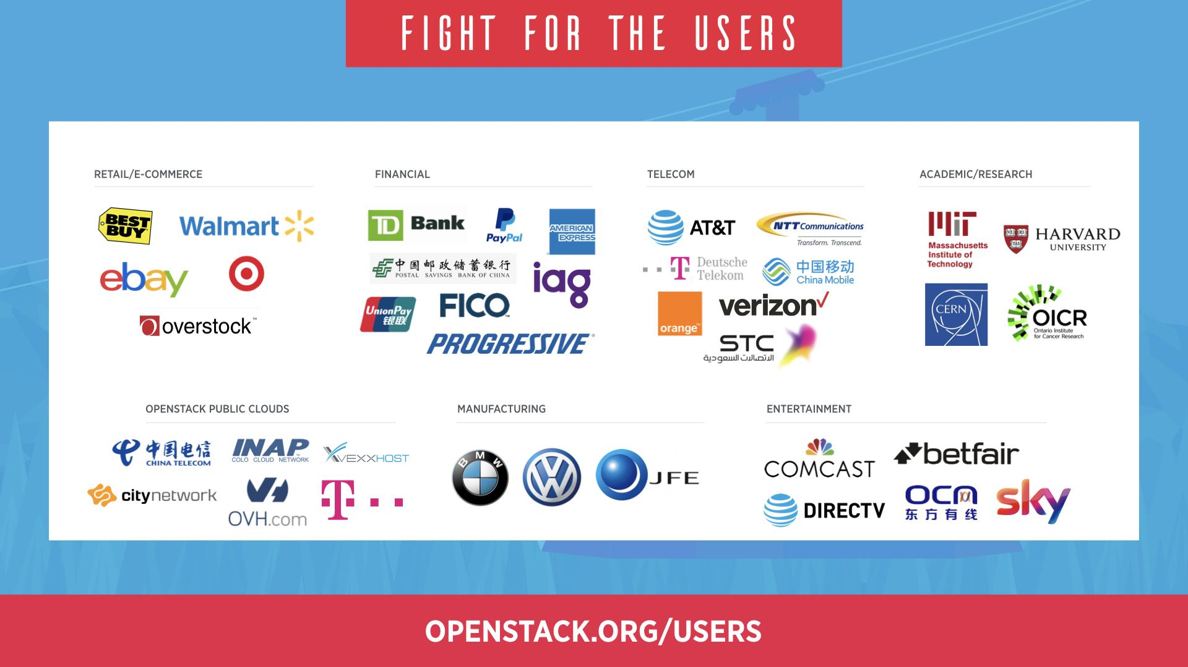

Slide 21
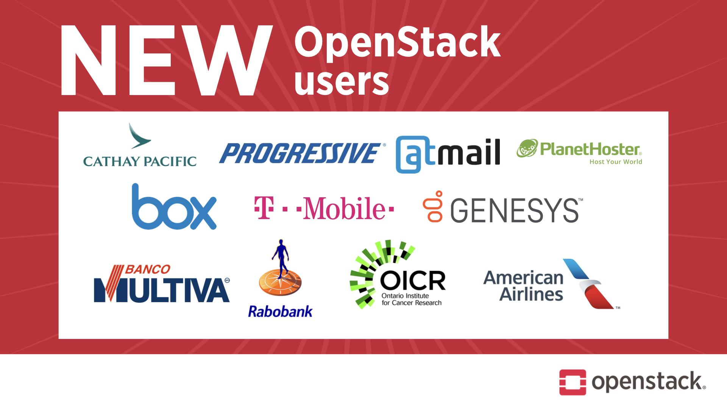

Slide 22
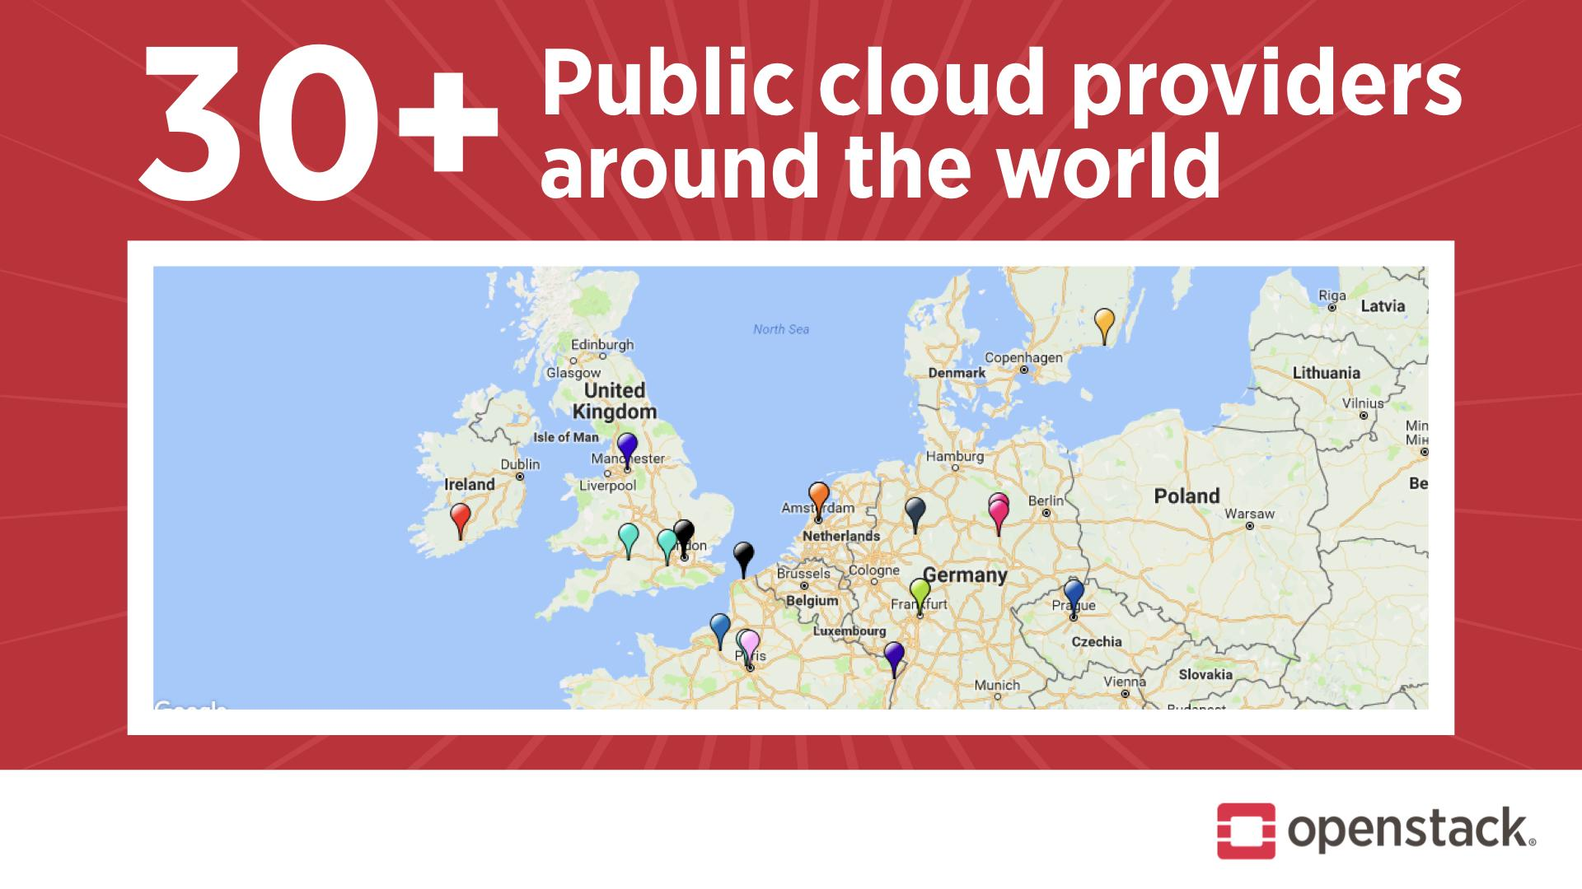

Slide 23
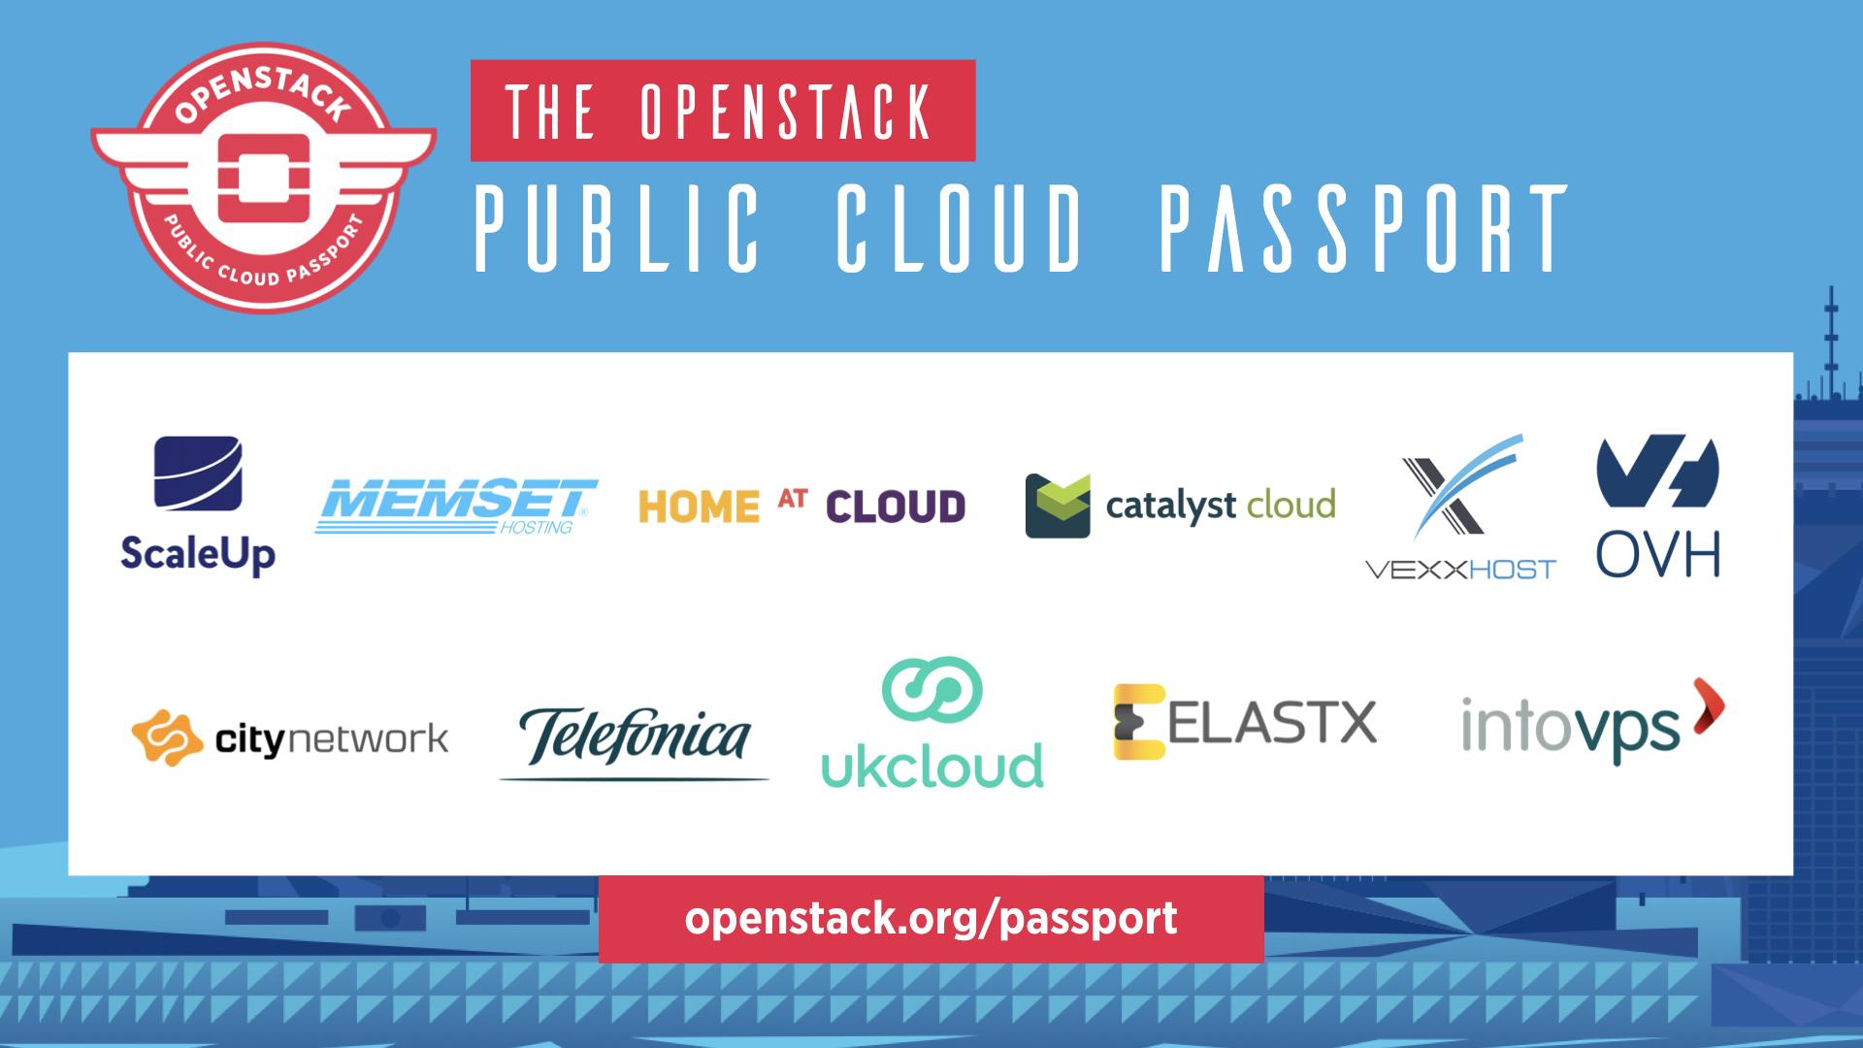

Slide 24
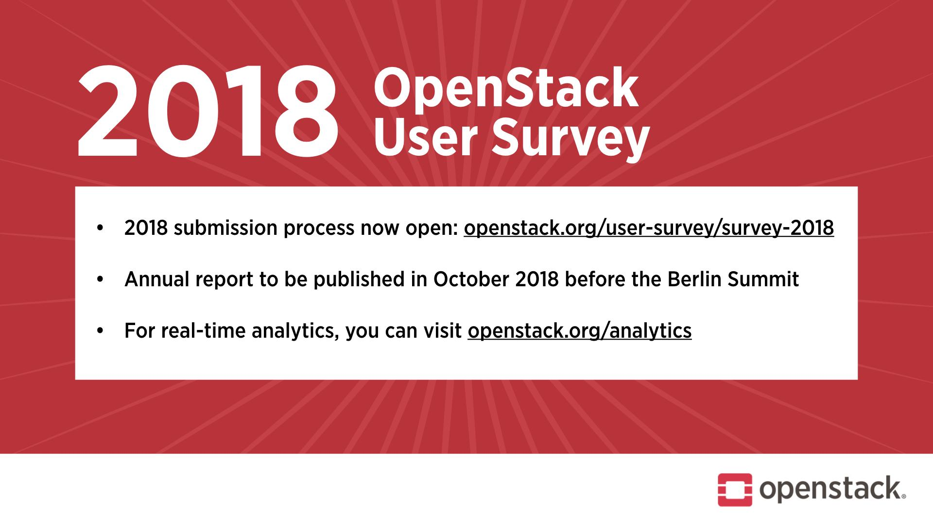

Slide 25
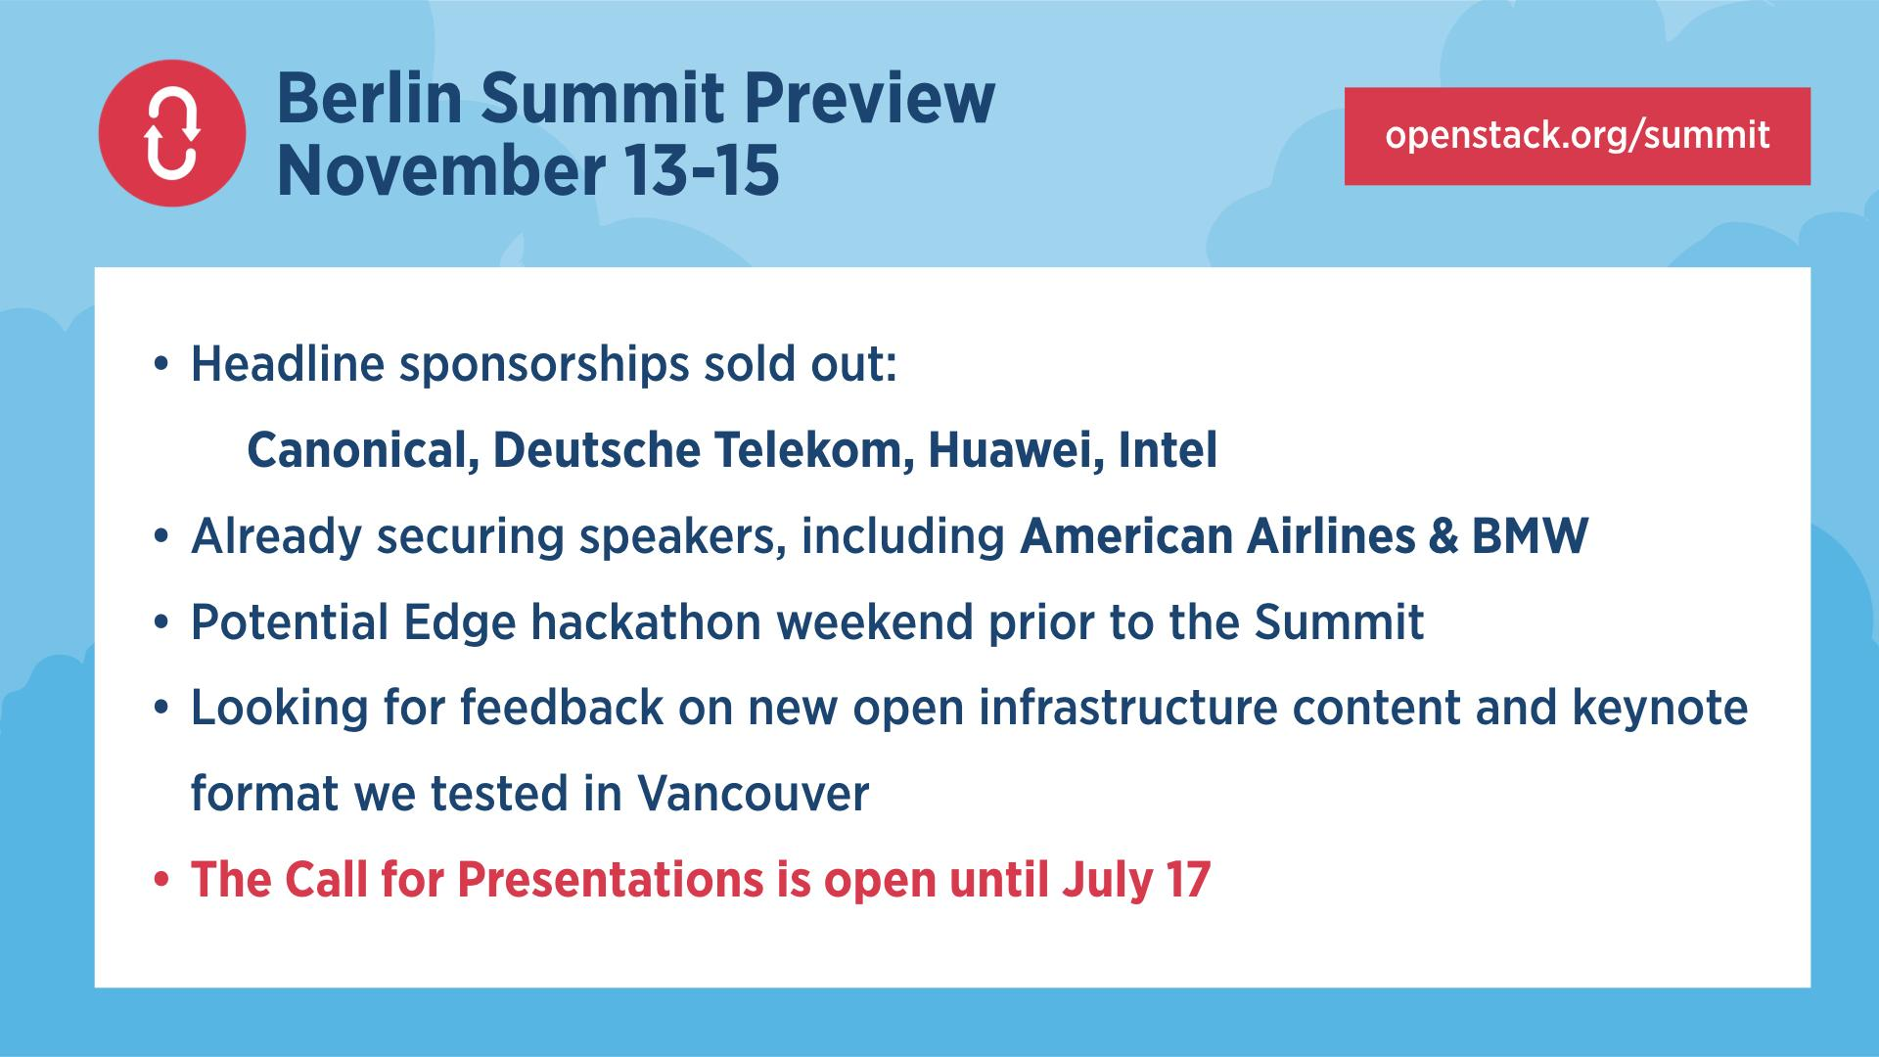

Slide 26
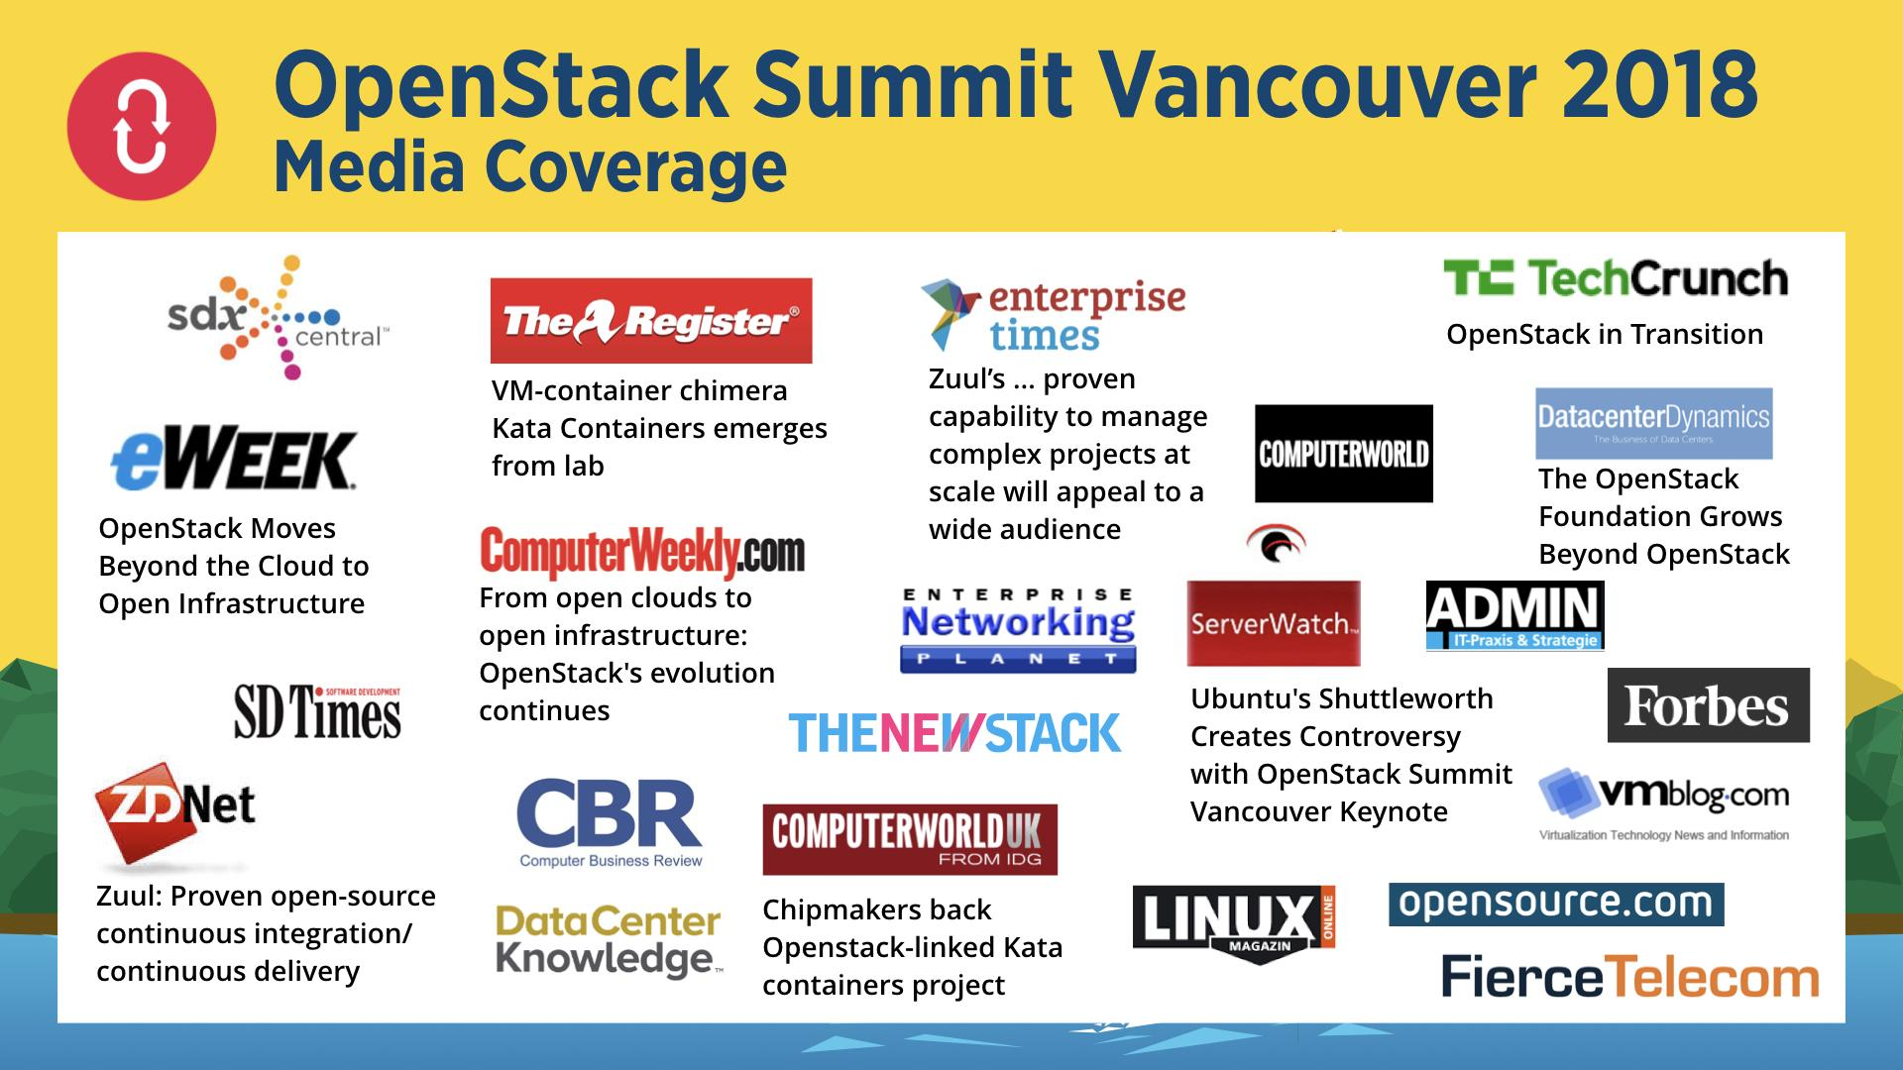

Slide 27


Slide 28
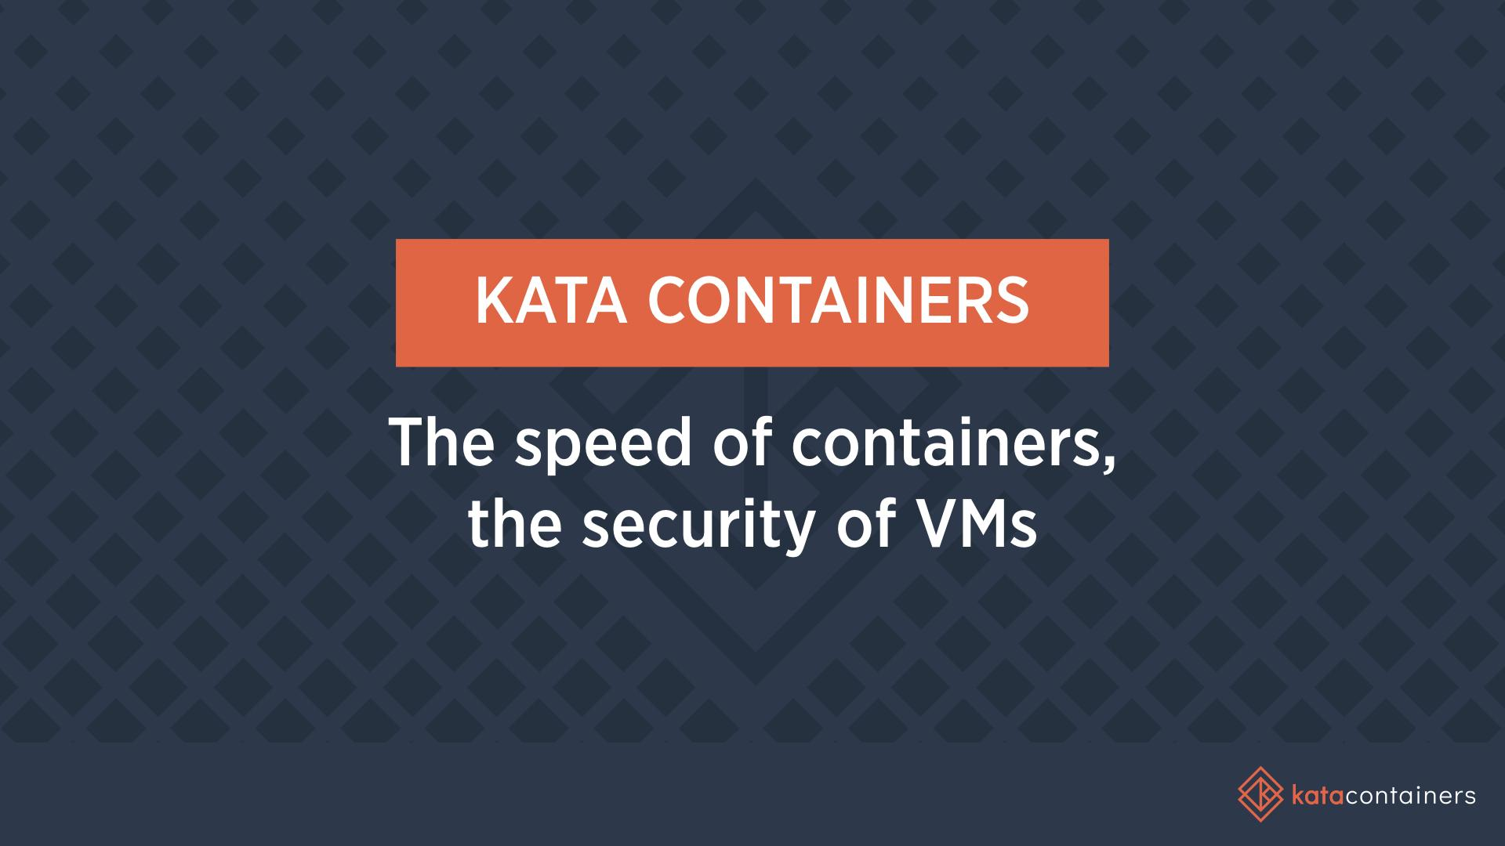

Slide 29
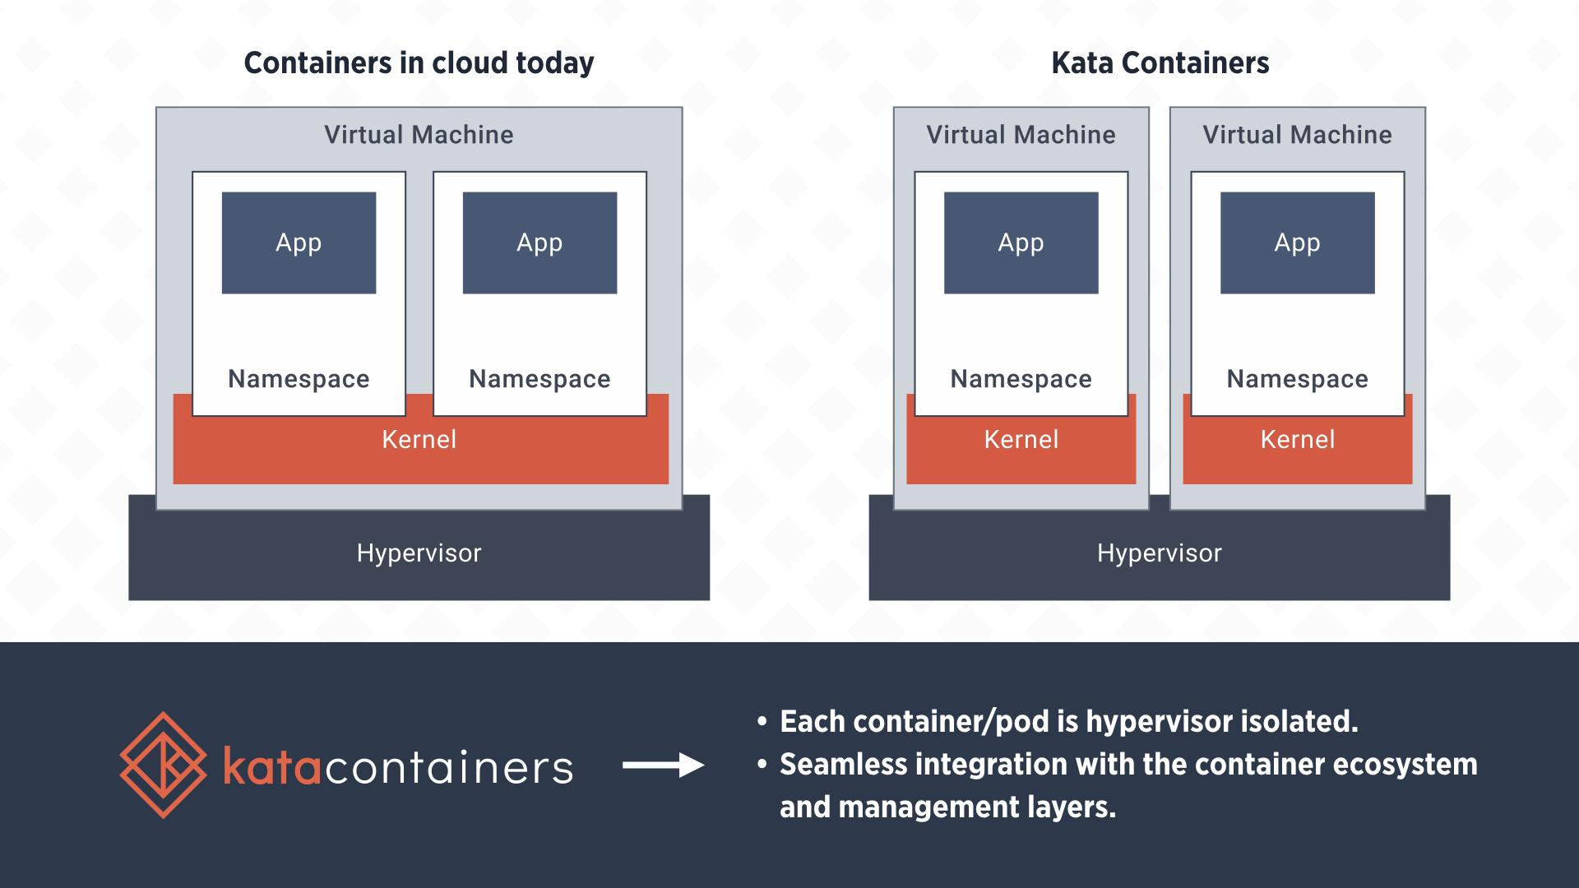
Notes:
With Kata Containers, each container or pod is isolated through its own VM and kernel. These aren’t full vms and kernels, but rather a lightweight vm and a mini-kernel for minimal impact on performance. We’re still producing performant containers, but now we have hardware-backed isolation between them.

Slide 30
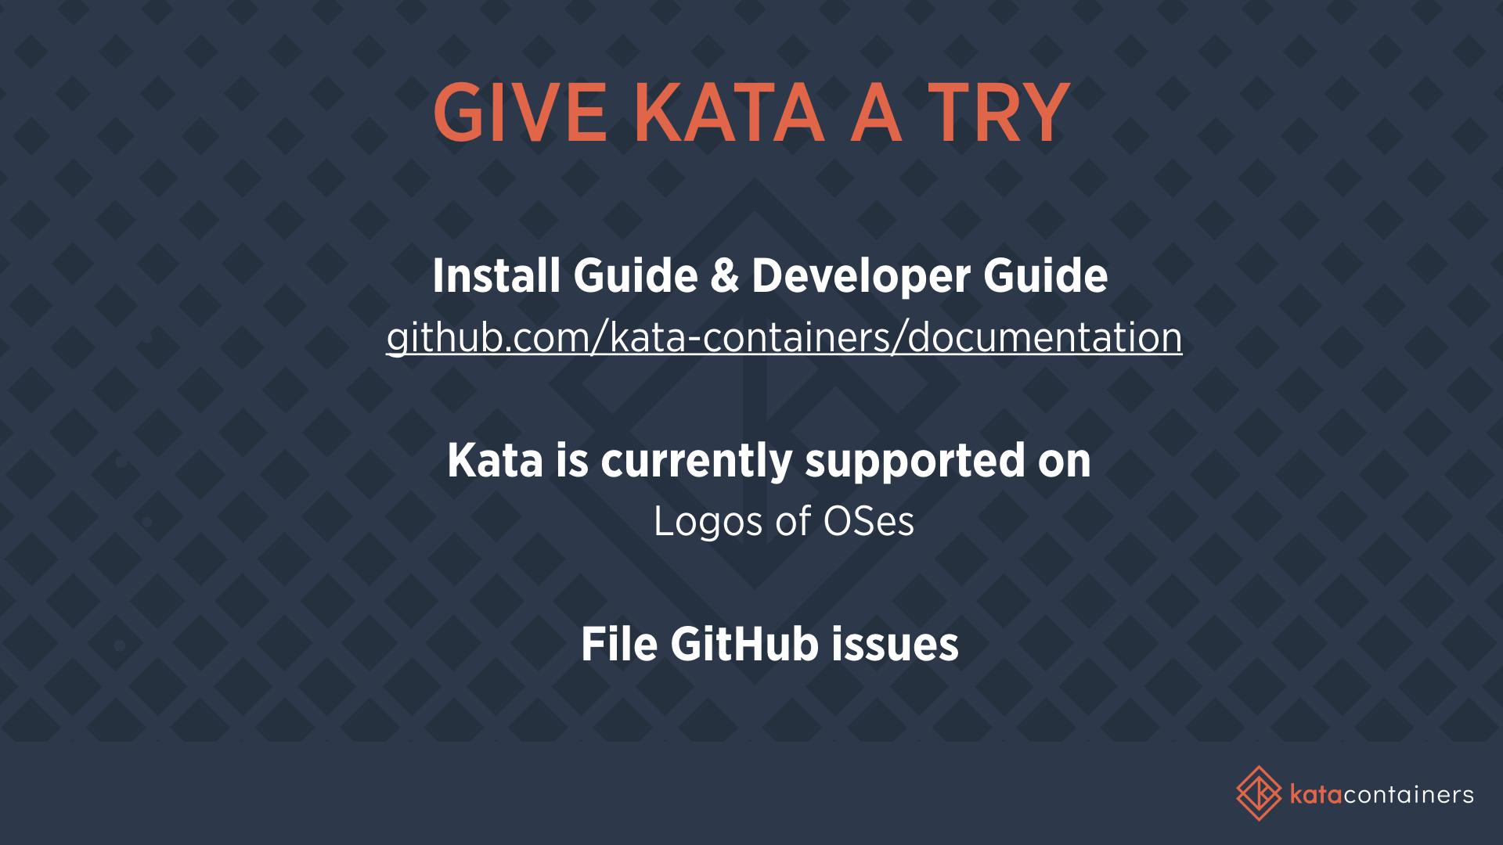

Slide 31
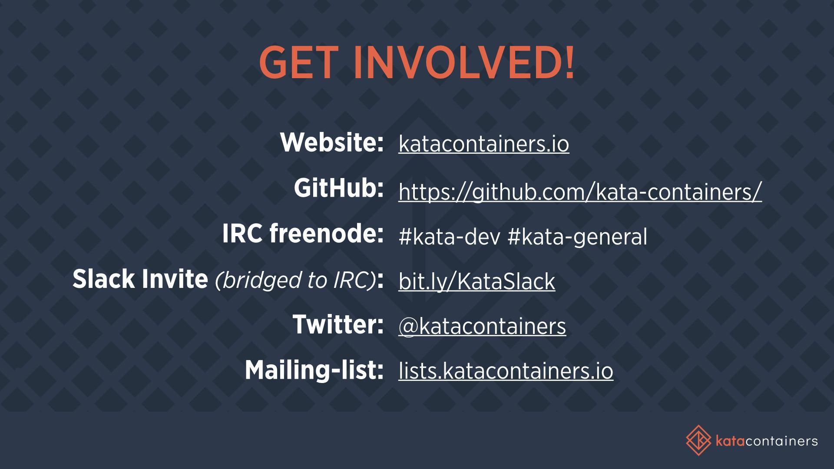
Notes:
Some info about where we hang out. We do use GitHub, which you’ll find at github.com/kata-containers
For both developer chats and general inquiries, we have a Slack and IRC channel with a bridge between them. There’s #kata-dev and #kata-general. If you’re a Slack person, that bit.ly will give you a slack invite. We also post community announcements and do some lengthier development discussions on the mailing list, that you can sign up for at lists.katacontainers.io. If you just want to check out what we’re up to, you can visit the website and sign up for general email announcements there.

Slide 32
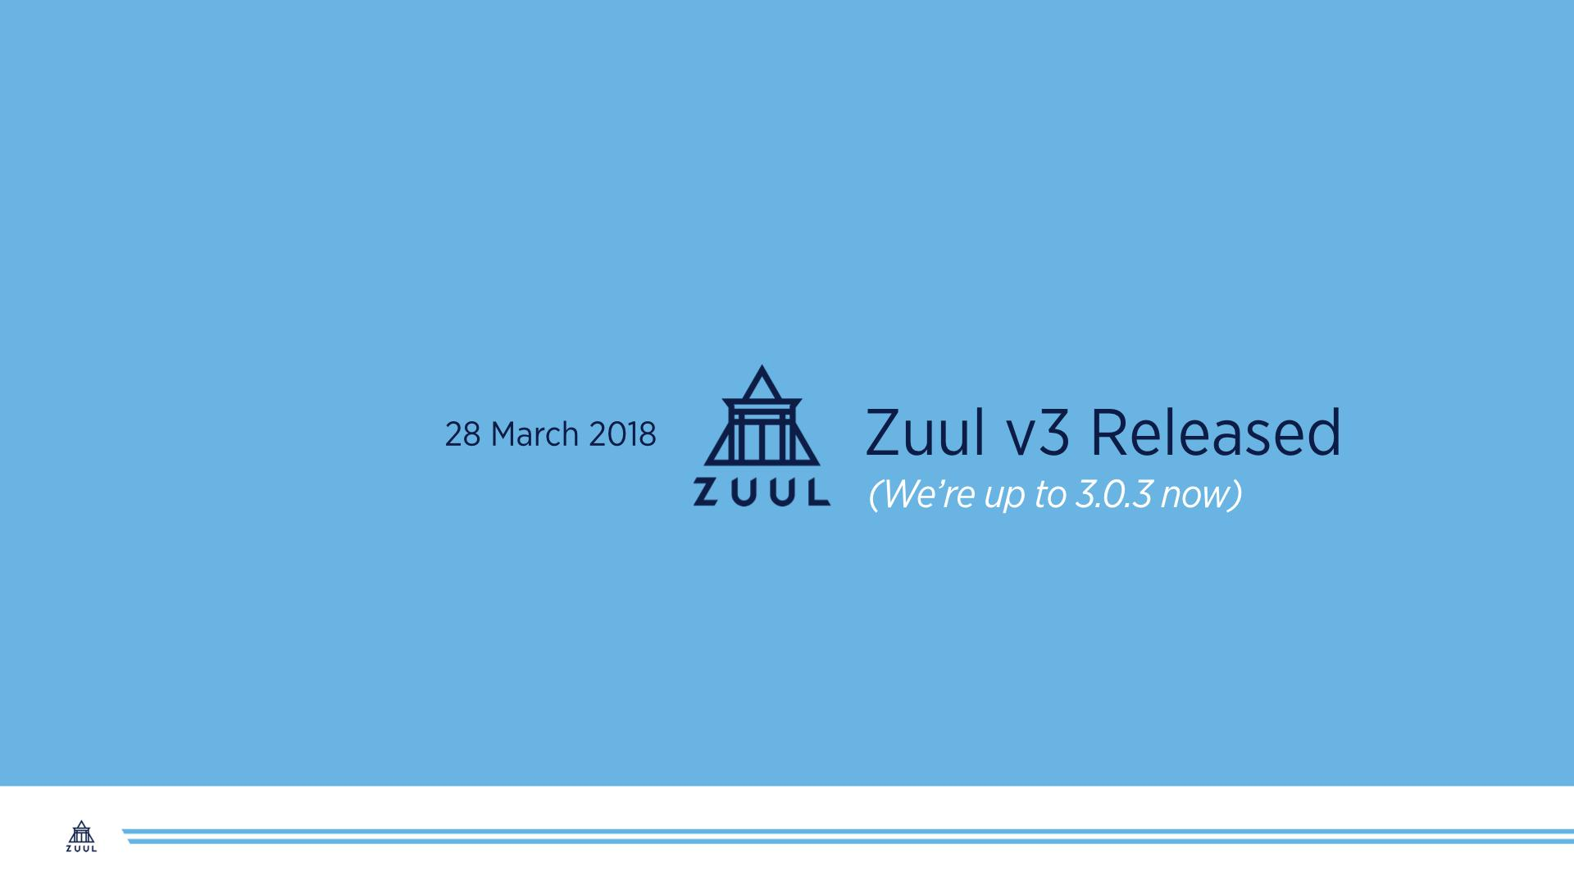
Notes:
Thanks to growing community we made a major new release
Zuul stands on its own, capable of handling openstack’s workflow and yours too
Tobias Henkel

Slide 33
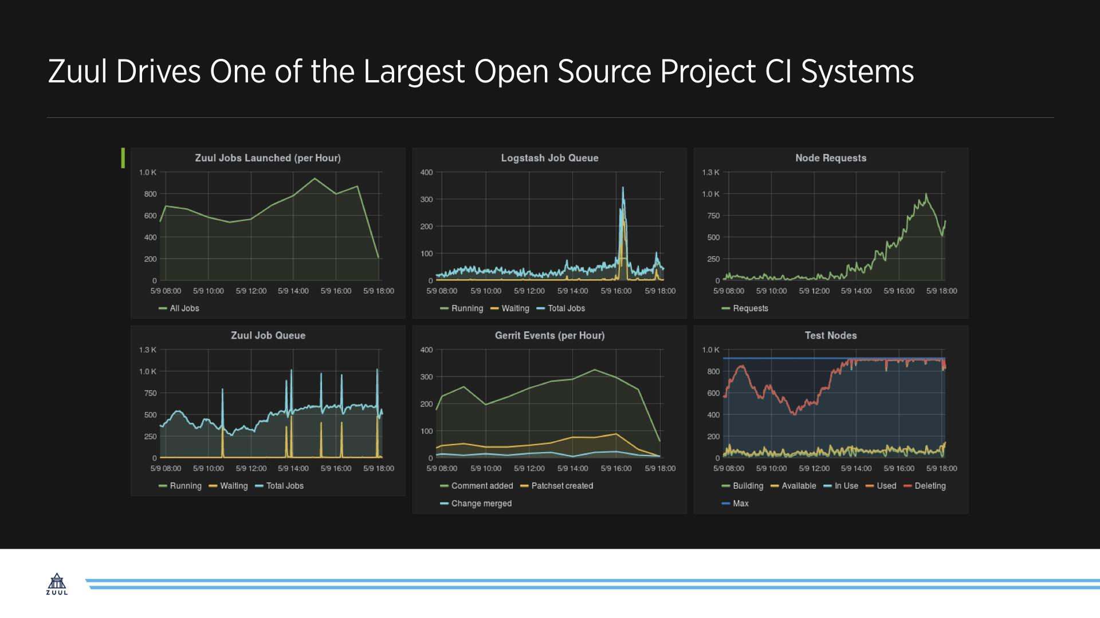
Notes:
Past 6 years, zuul has quiently been running one of largest public cy systems for one of largest os projects
Sysadmins and devs working behind the scenes
Test patch before land
Git-driven development and ops
People need what we’ve been building
Software dev is highly interdependent and operations increasingly driven by software
Zuul is engine that drives that in openstack project, and we want to share

Slide 34
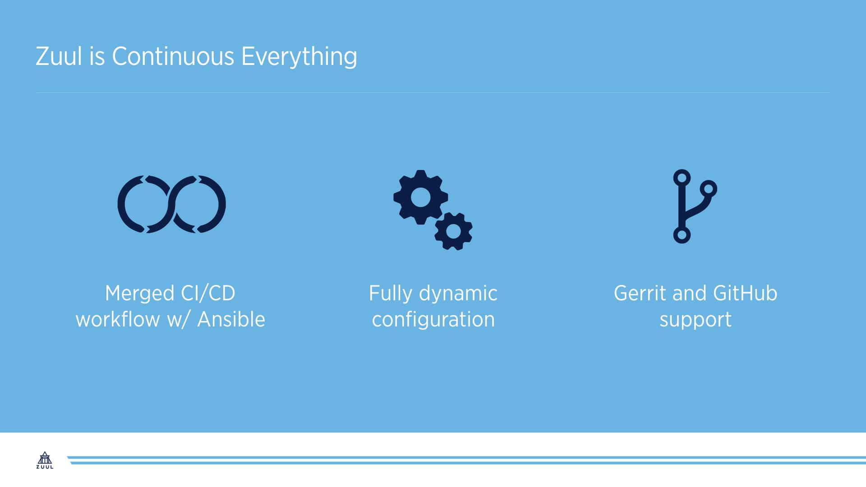
Notes:
* Jobs in ansible
Ansible can deploy any software; metal, vms, etc
Huge ecosystem of 3rd party modules
Write ansible playbook to deploy system in prod and use the same playbook in ci.
Dev, testing, deployment are merged
* Reads config from git repos
When someone proposes a change, evals dynamically
Given devs flexibility to create adhoc ci tystes
Ultimate in gitops – testing/reviewing changes to automation system before they land
* Gerrit, github, ghe
Integrate multiple projects in testing, cross communities

Slide 35
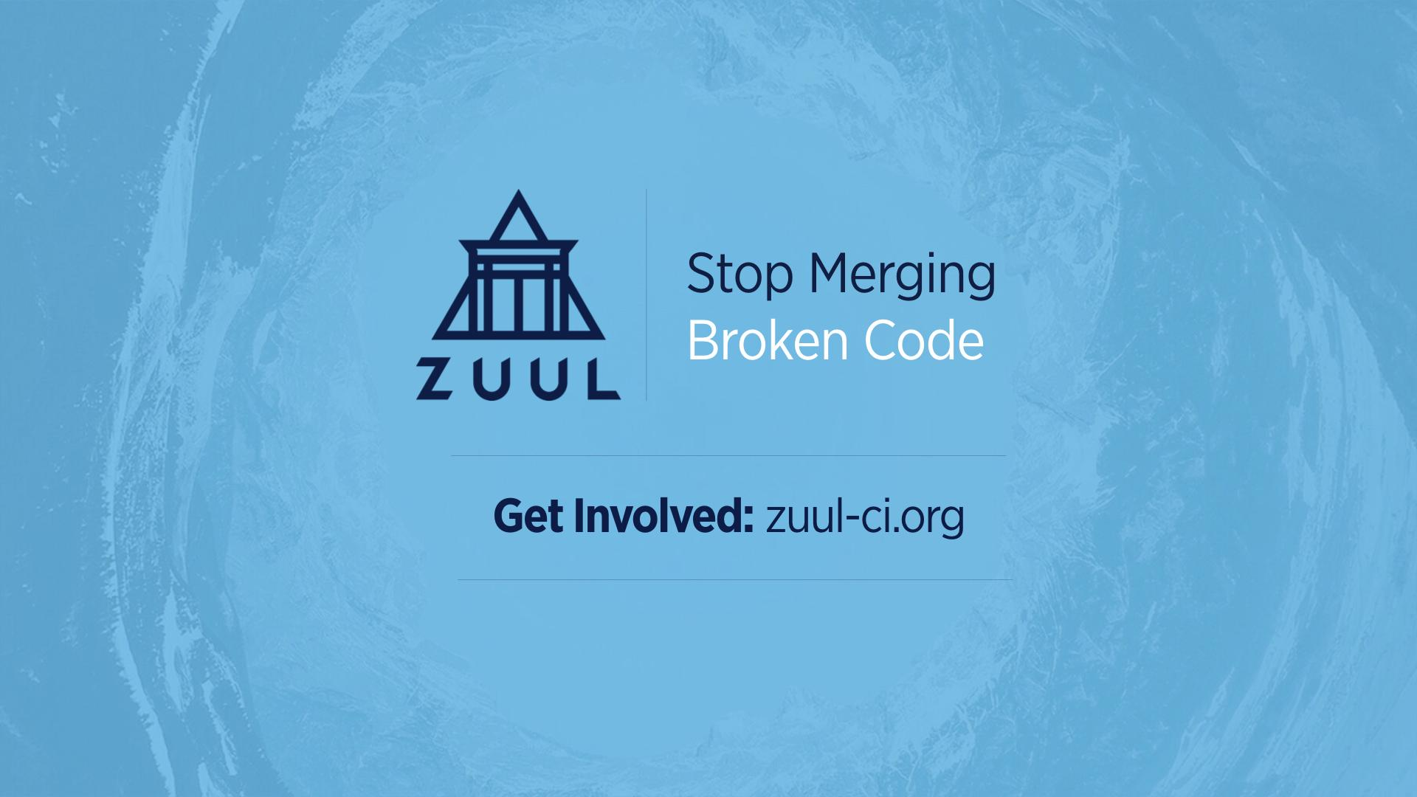

Slide 36
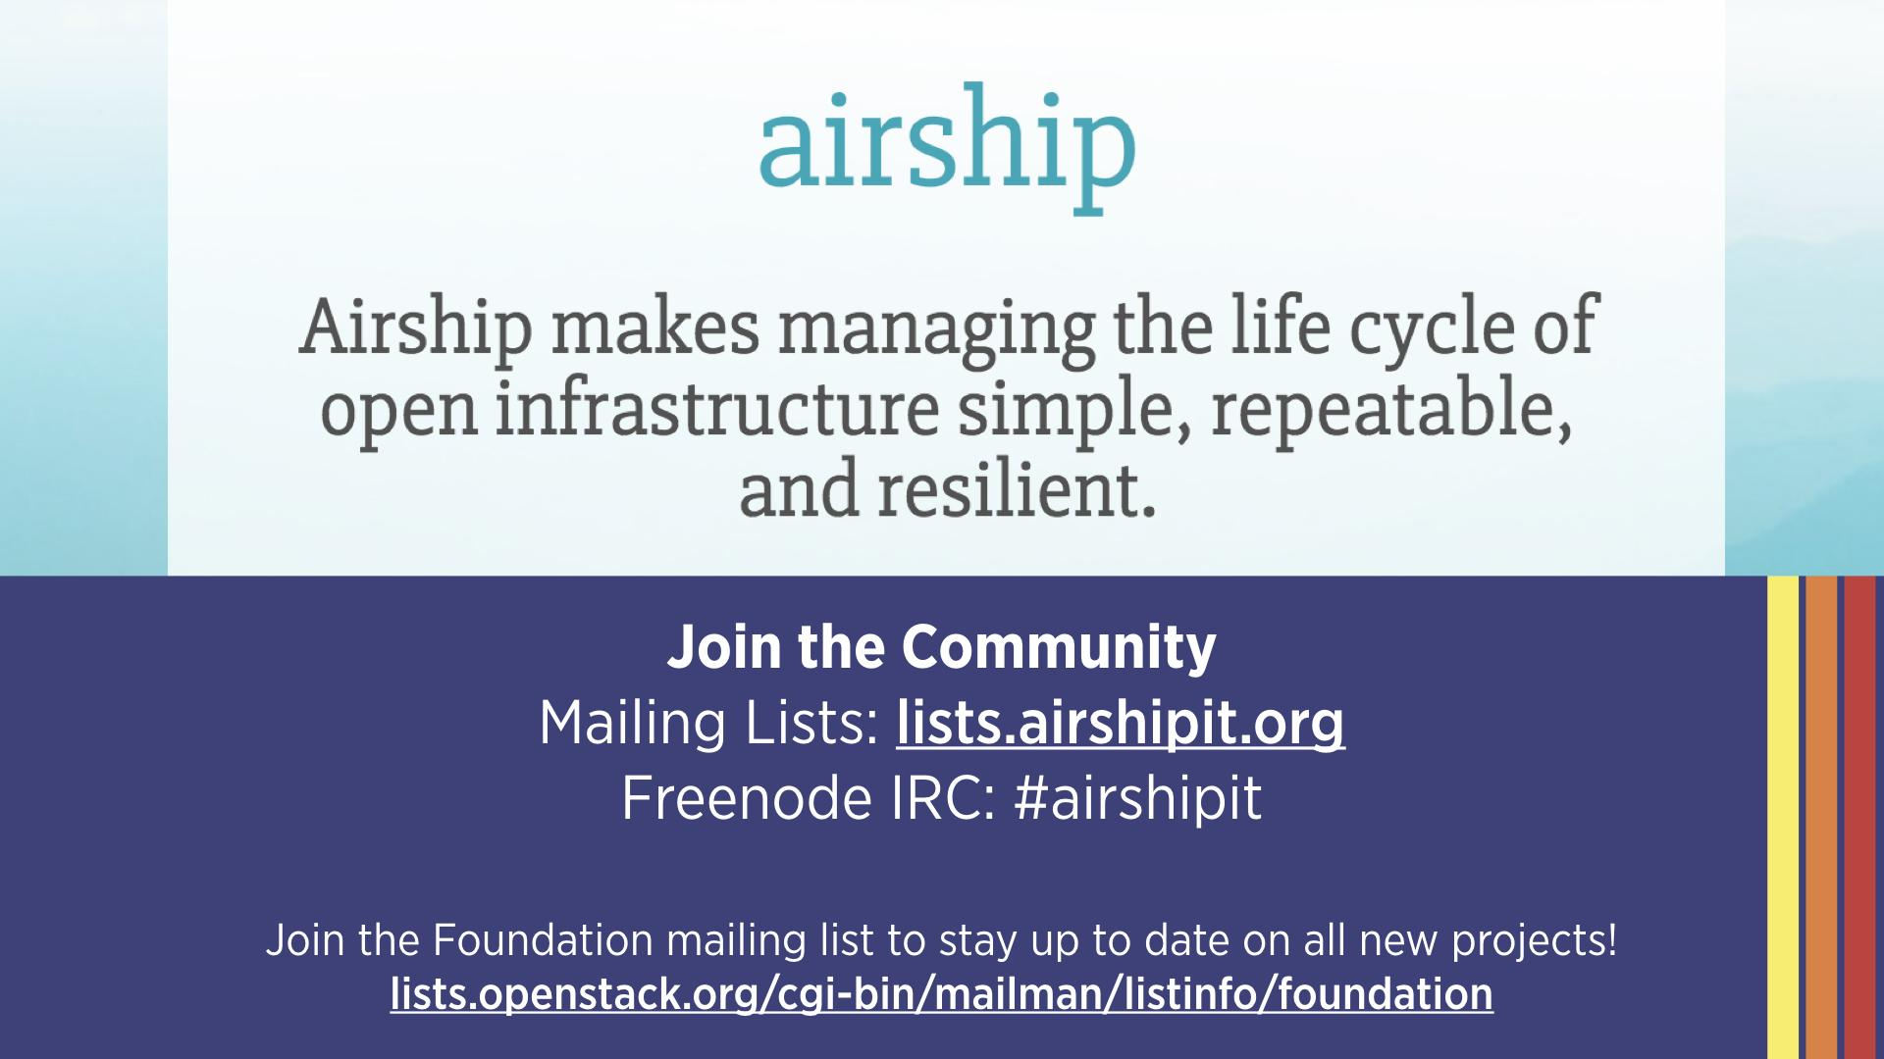

Slide 37
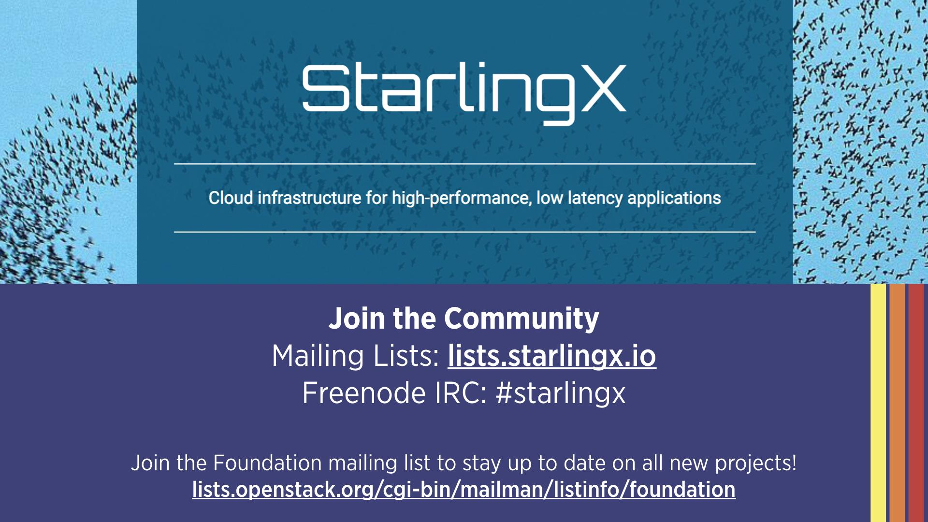

Slide 38
